Slide 1
Aneuploidy Project: Correlations Between Different Datasets

Slide 2
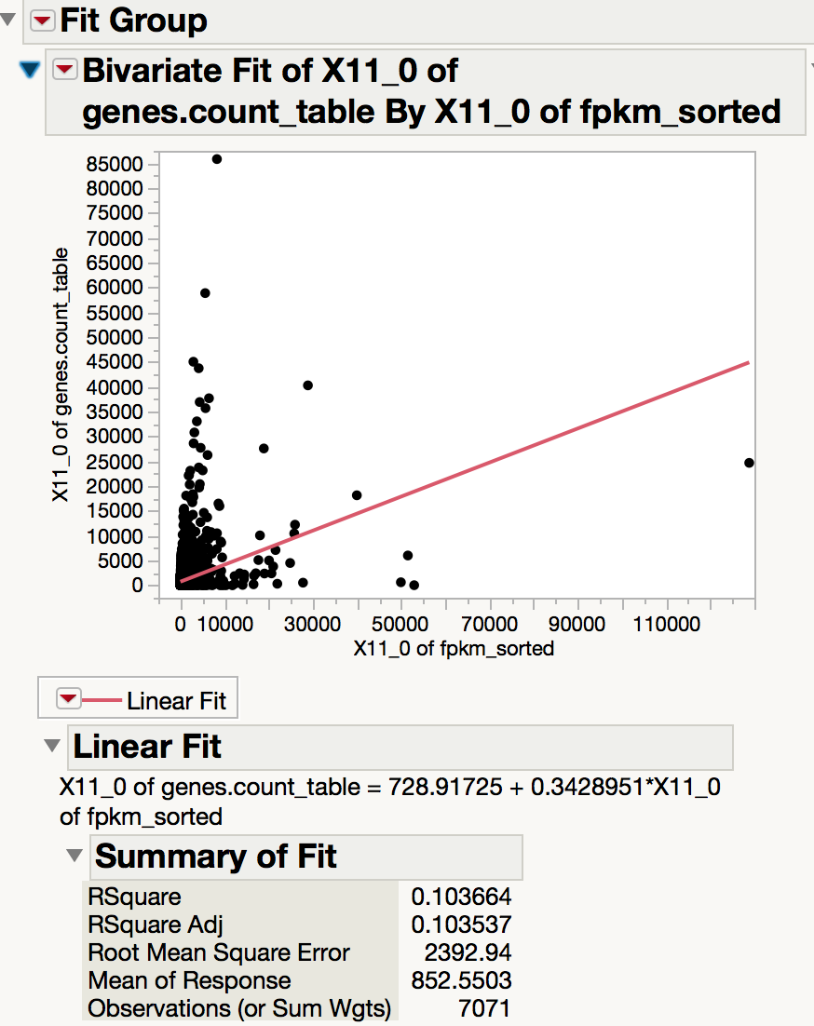
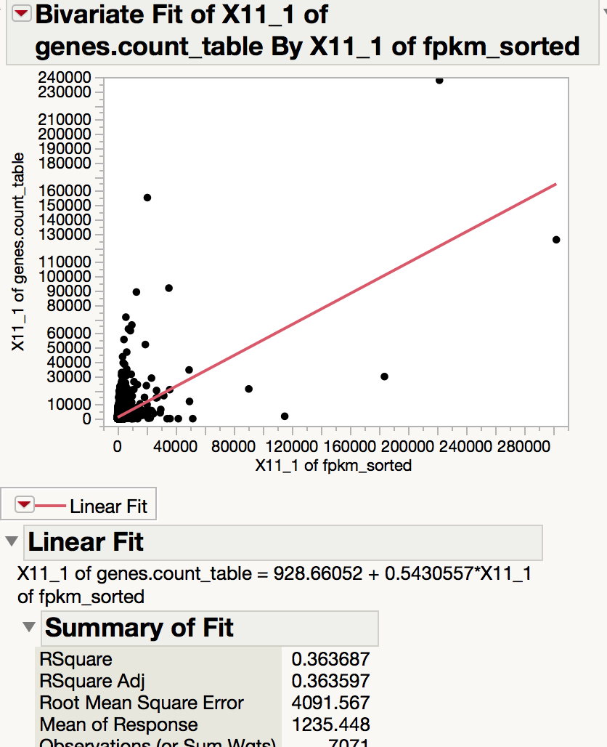
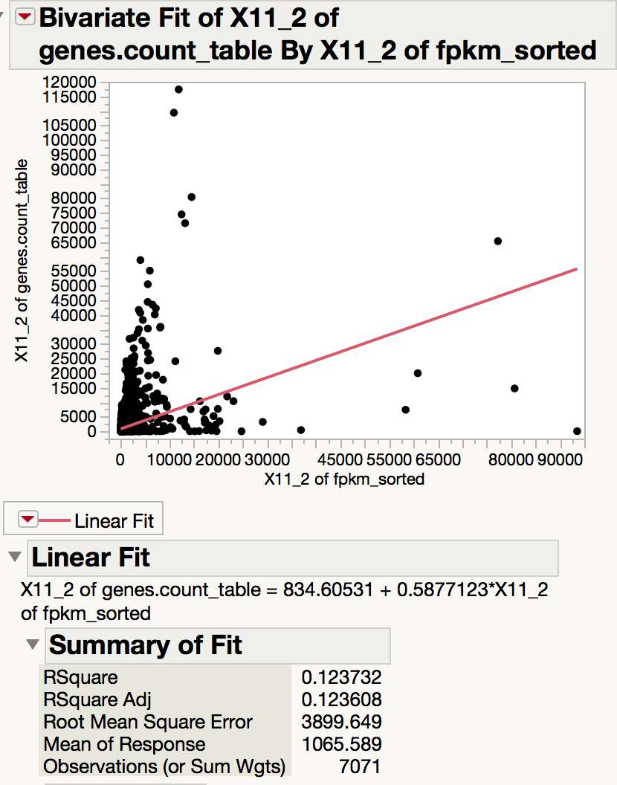
Cuffnorm: FPKMs versus counts: aneuploid line
Normalized counts versus fpkms
Average R^2 value: 0.196

Slide 3
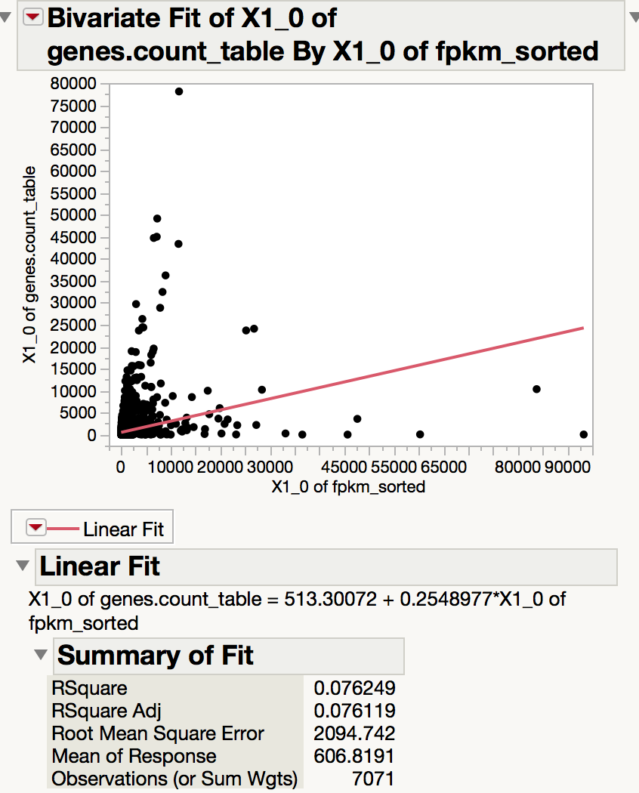
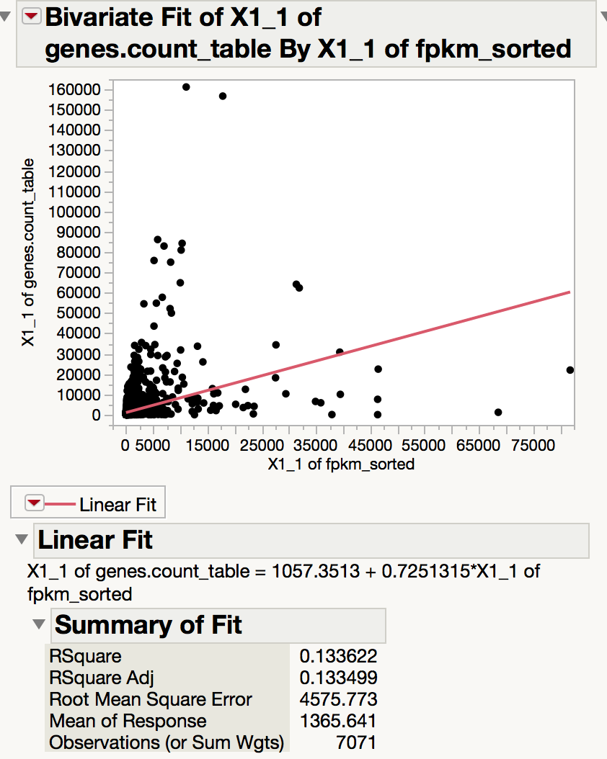
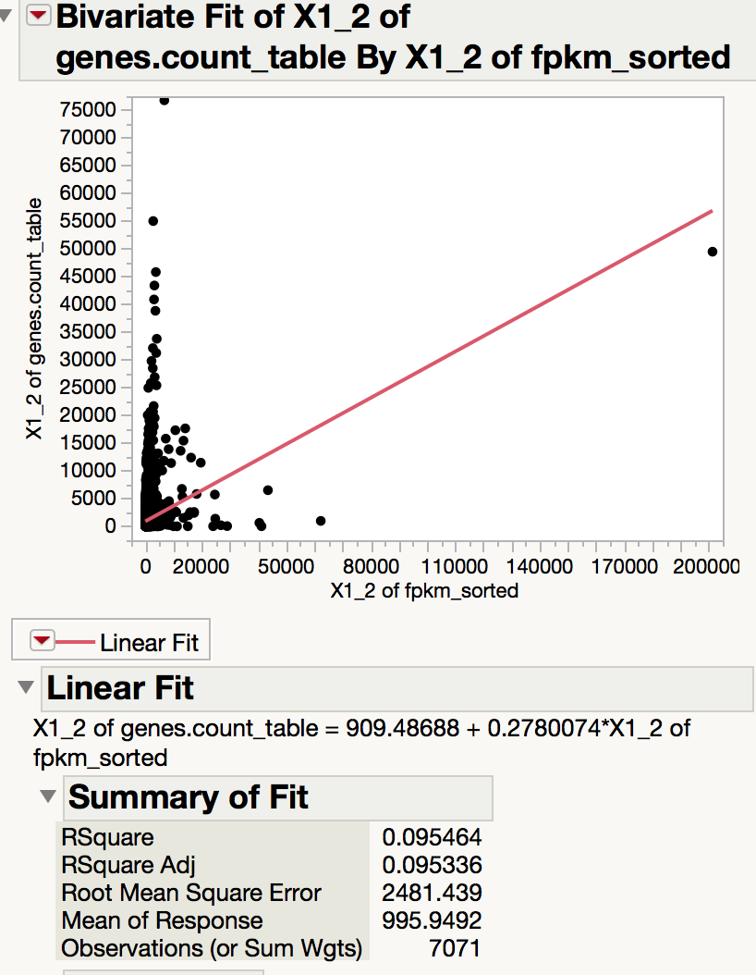
Cuffnorm: FPKMs versus counts: euploid line
Average R^2 value: 0.1017

Slide 4
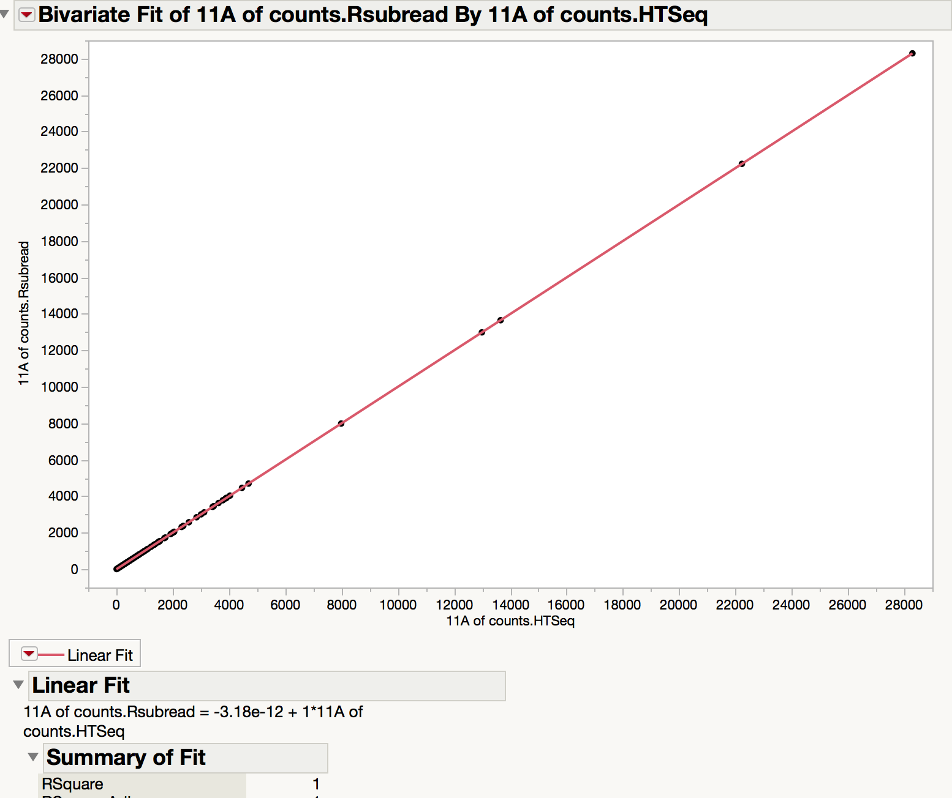
Counts: htseq-count (stranded) versus Rsubread (stranded)
Perfect 1:1 ratio.
Unnormalized

Slide 5
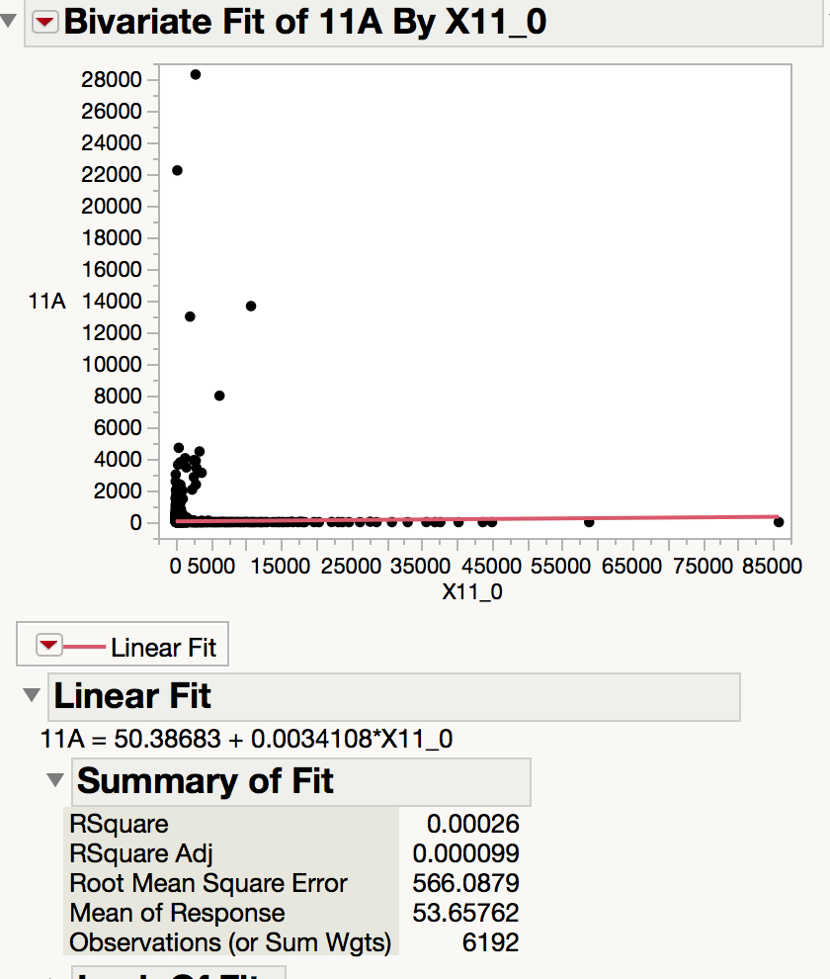
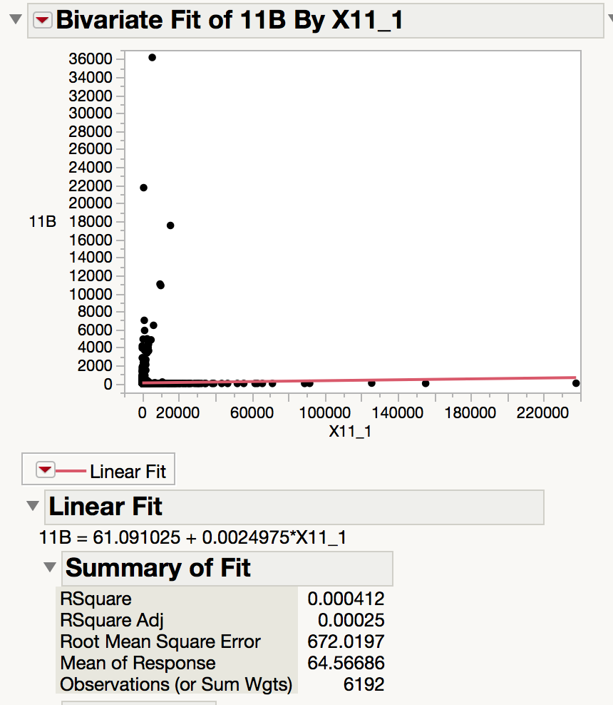
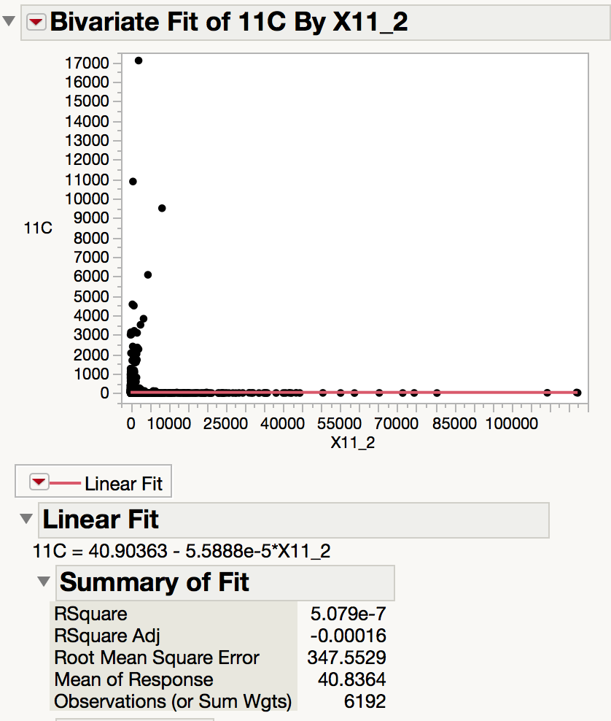
Counts: htseq-count versus Cuffnorm counts
Question: does Cuffnorm normalize the counts in the gene counts table it outputs?

Slide 6
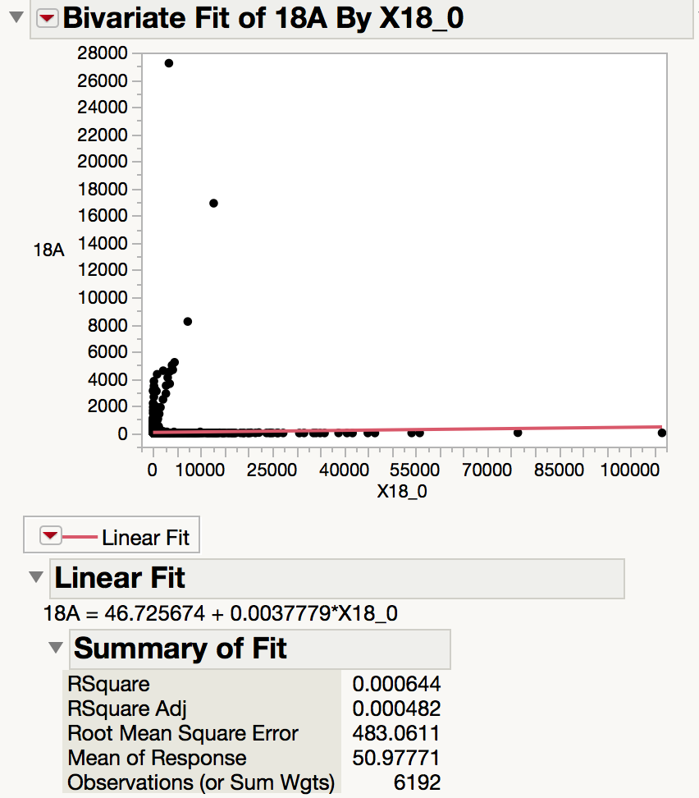
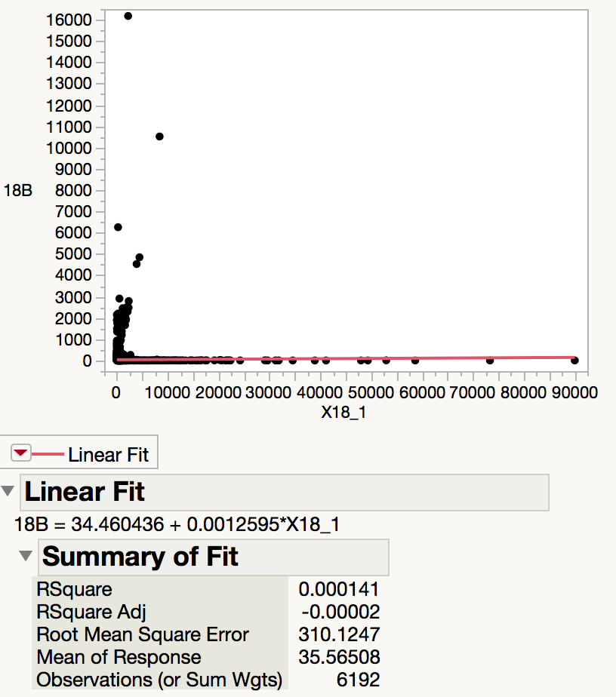
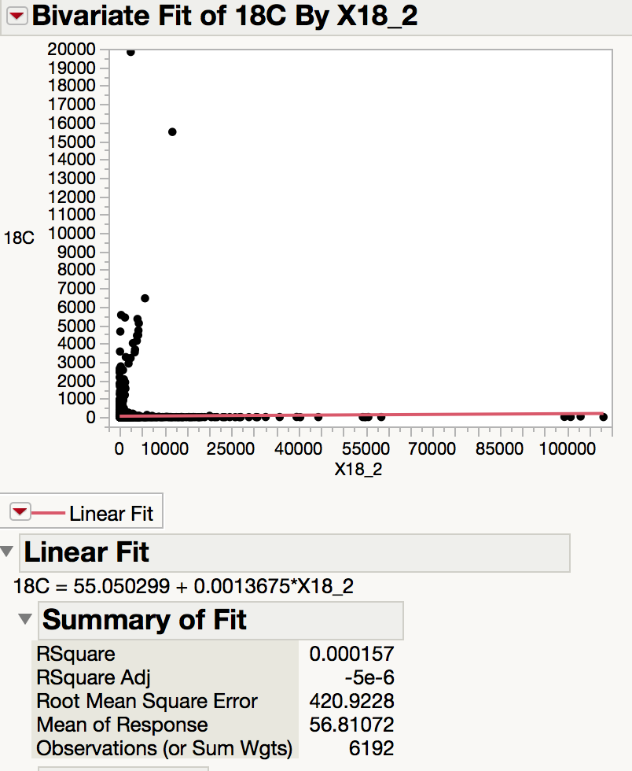
Counts: Rsubread versus Cuffnorm counts

Slide 7
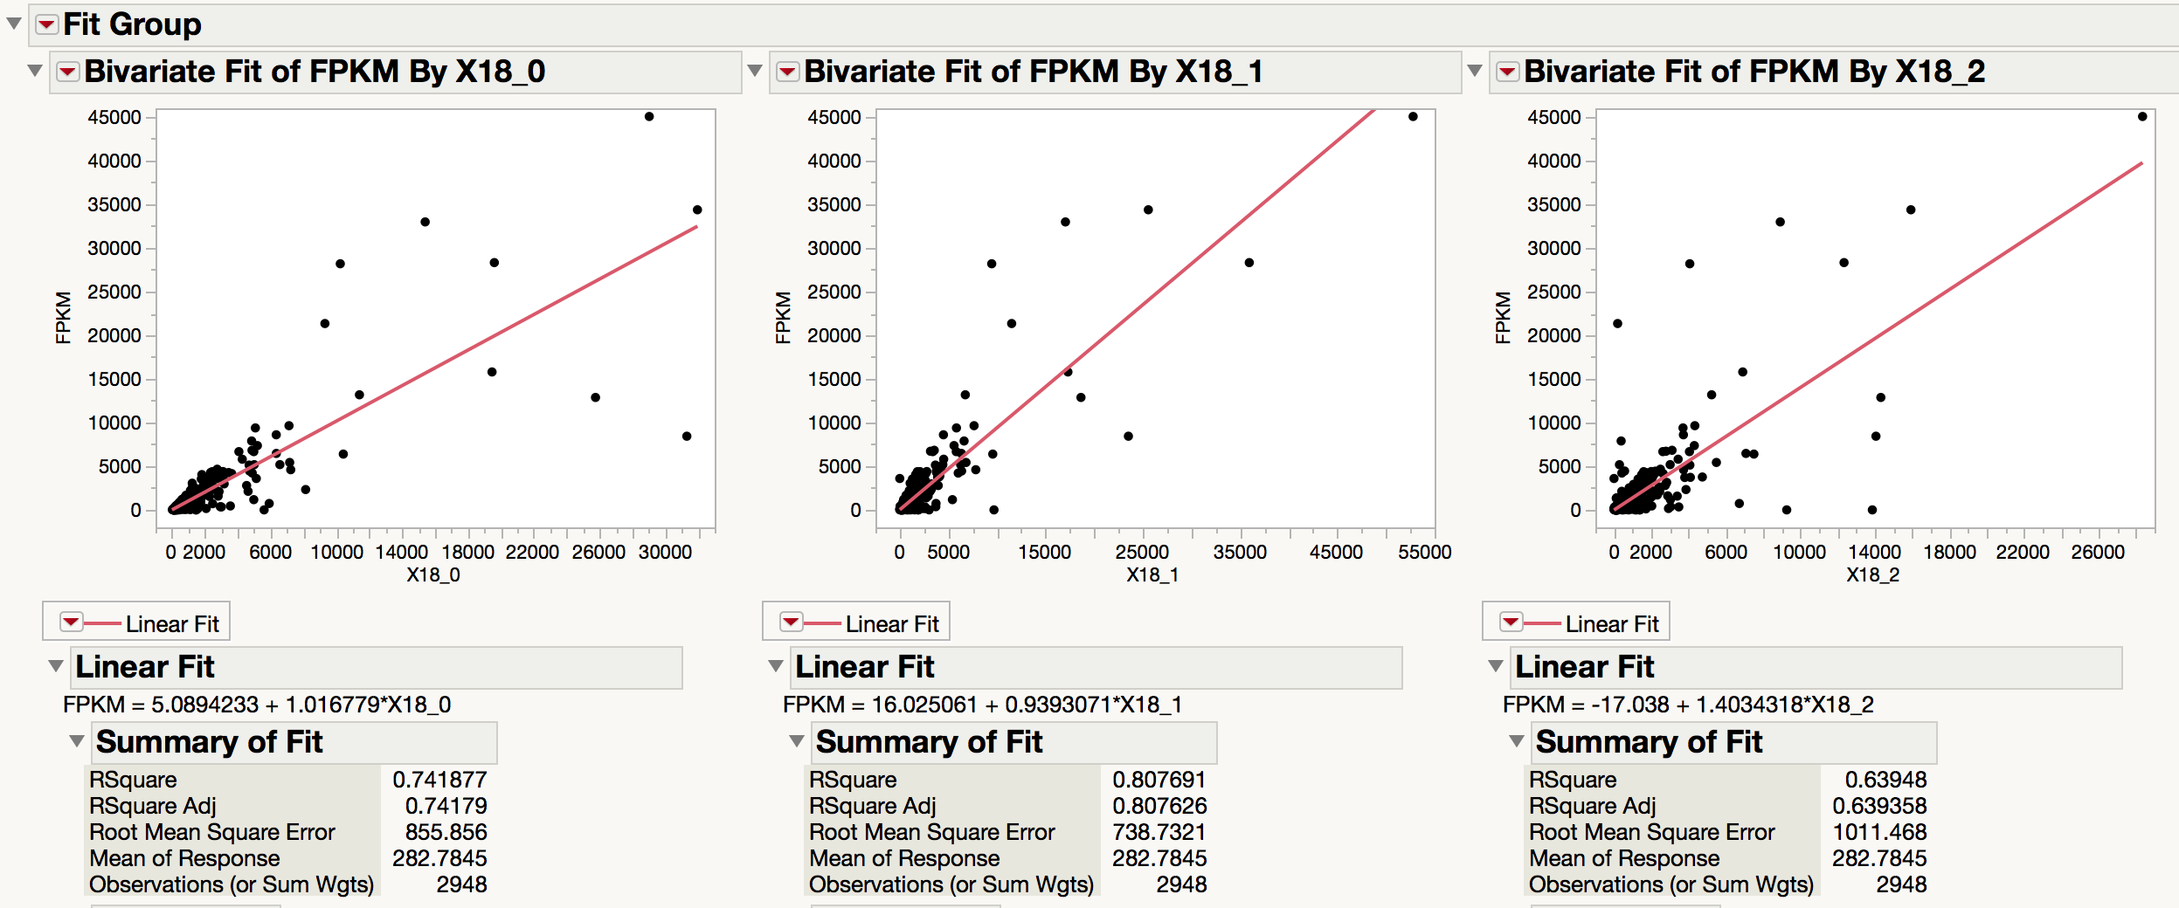
Cufflinks/Cuffnorm: FPKMs from Cufflinks(unstranded) versus FPKMs from Cuffnorm

Slide 8
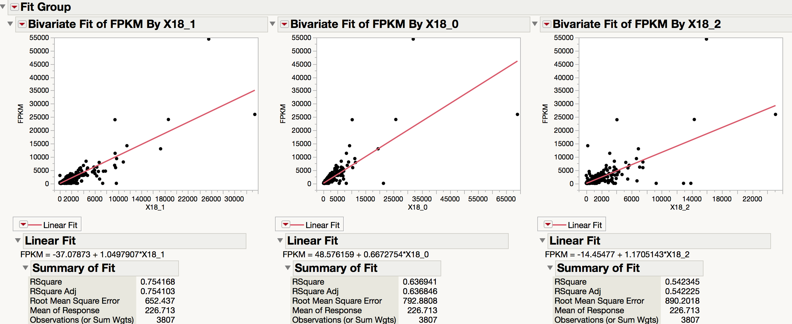
Cufflinks/Cuffnorm: FPKMs from Cufflinks (first strand) versus FPKMs from Cuffnorm

Slide 9
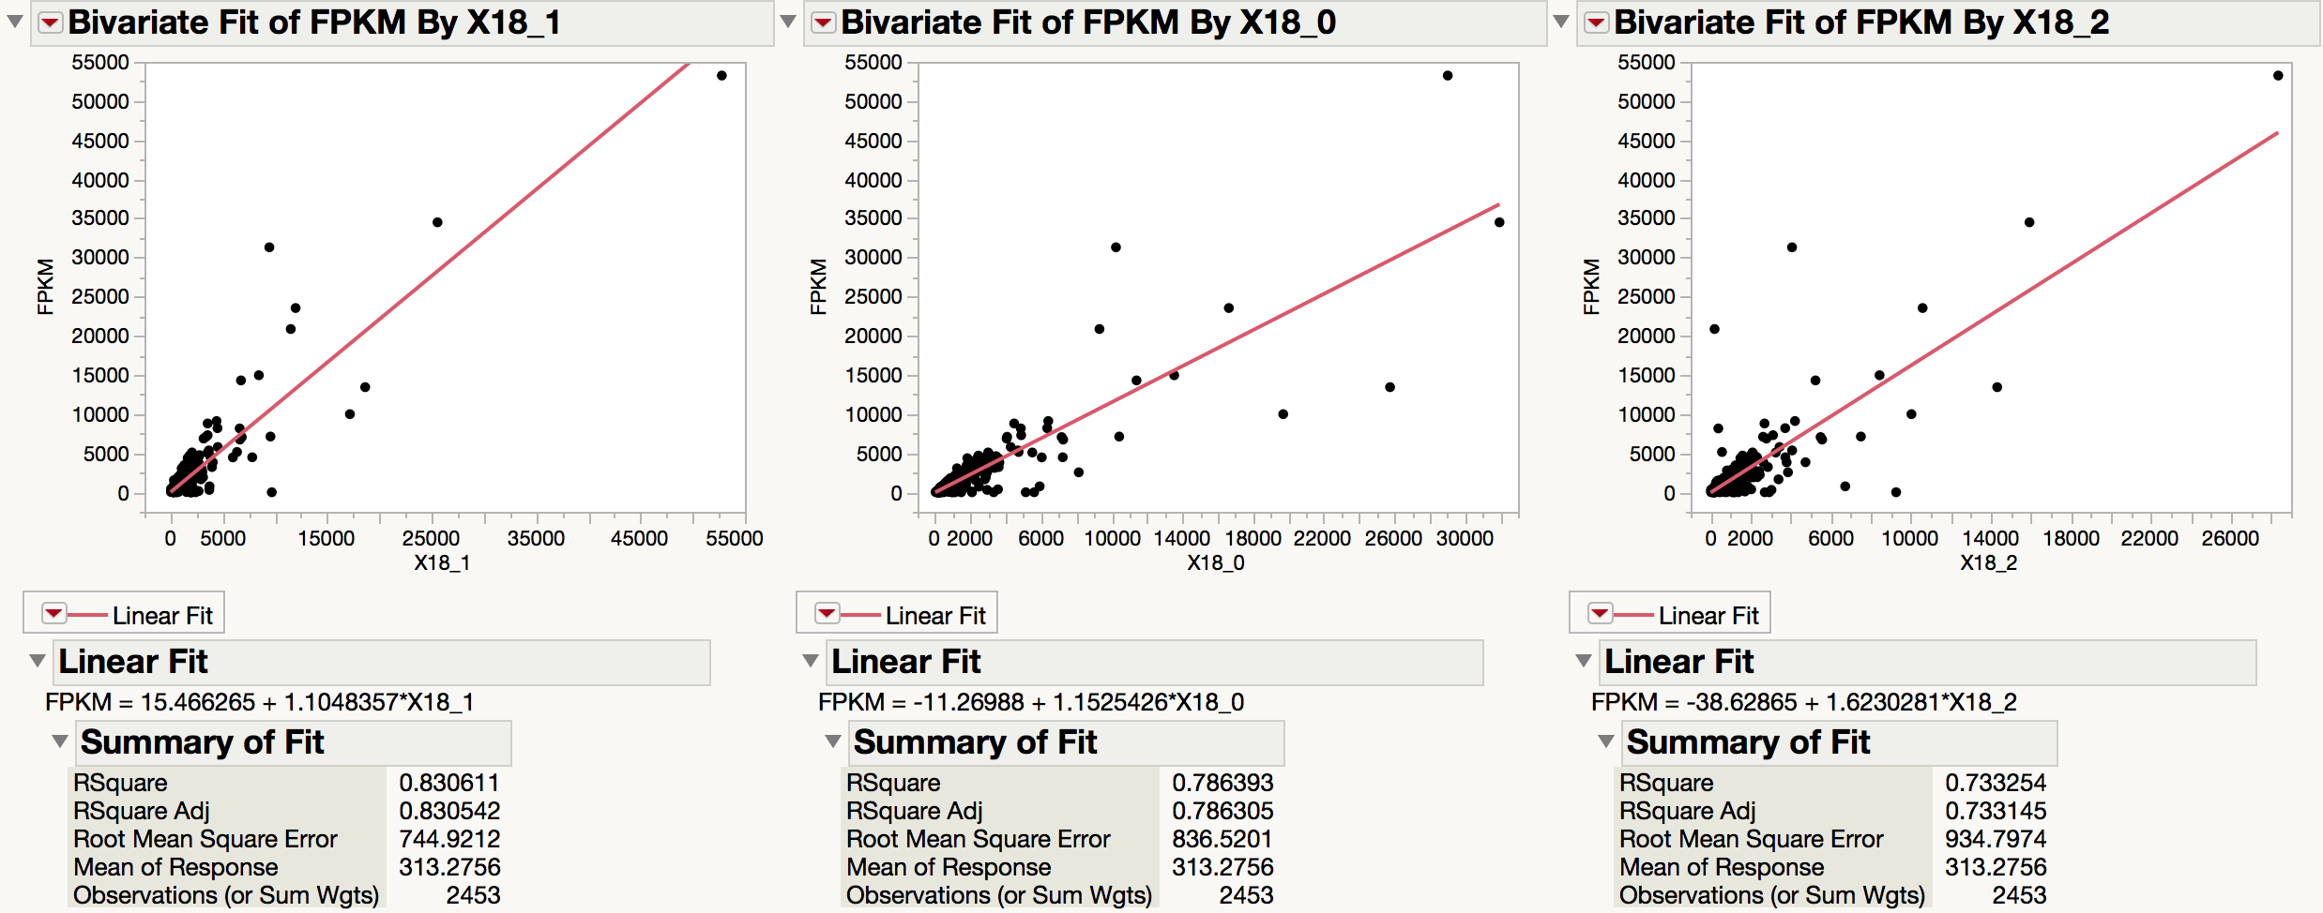
Cufflinks/Cuffnorm: FPKMs from Cufflinks (second strand) versus FPKMs from Cuffnorm

Slide 10
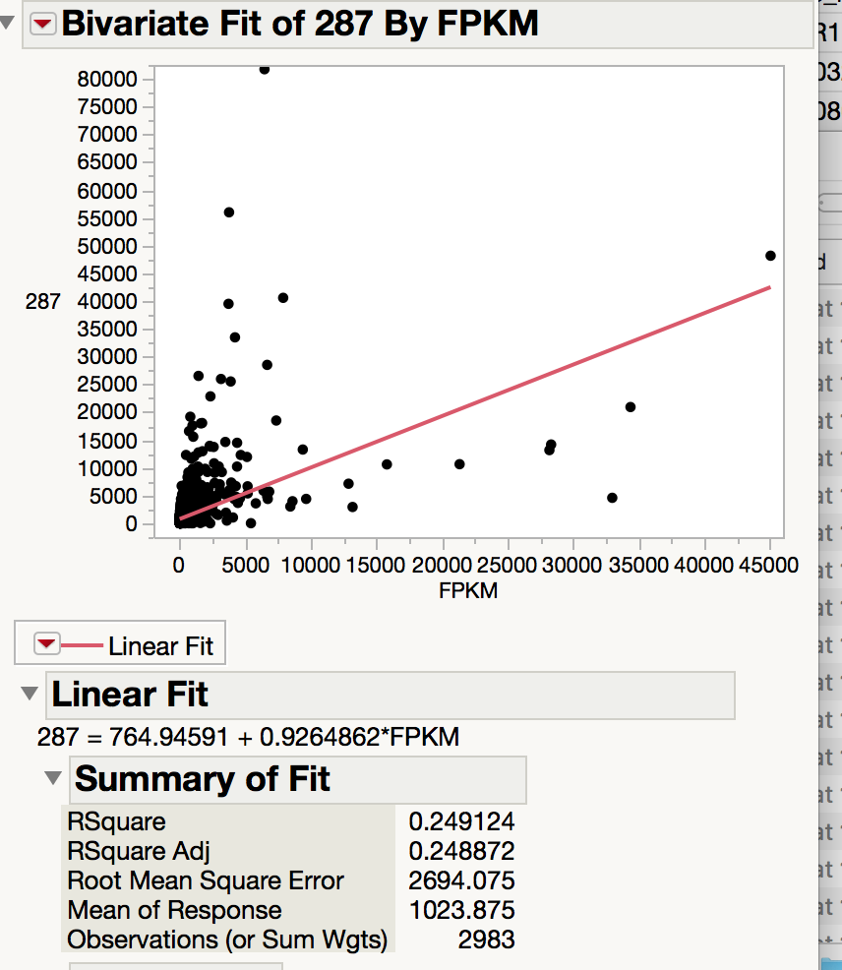
Cufflinks, default settings (unstranded) by htseq-count, unstranded

Slide 11
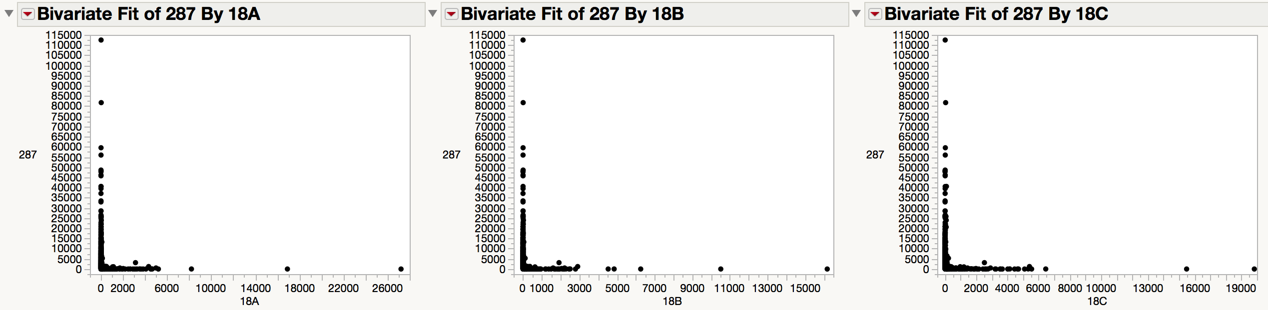
Htseq-count unstranded by rsubread, stranded

Slide 12
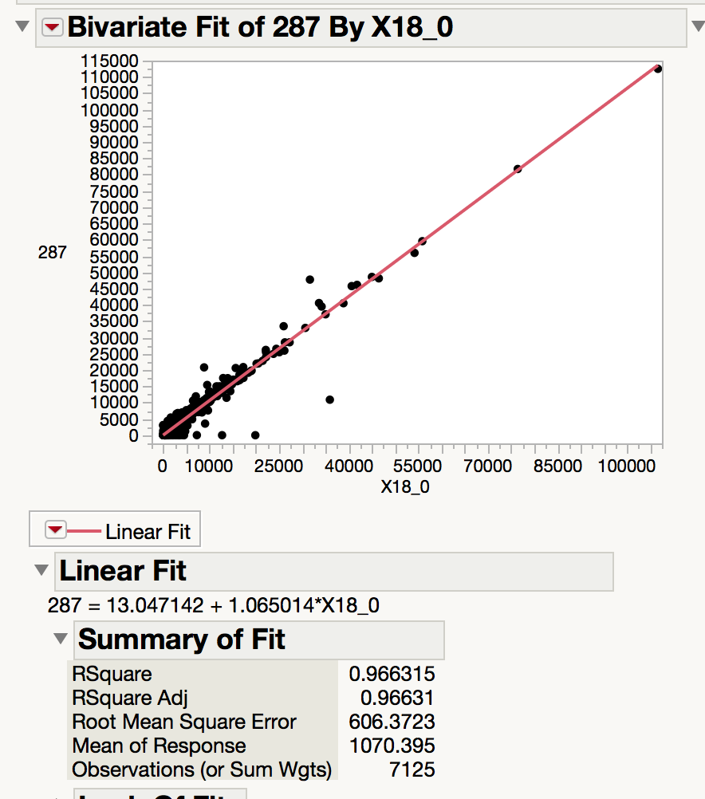
Cufflinks: gene counts versus htseq-count: unstranded

Slide 13
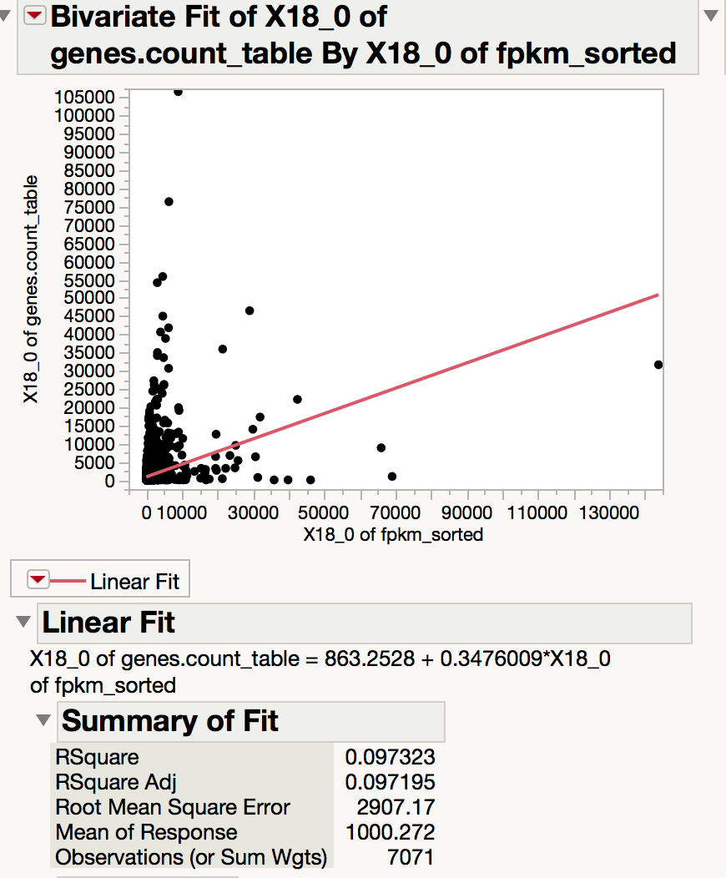
Cufflinks: gene-counts versus Cufflinks: fpkm

Slide 14
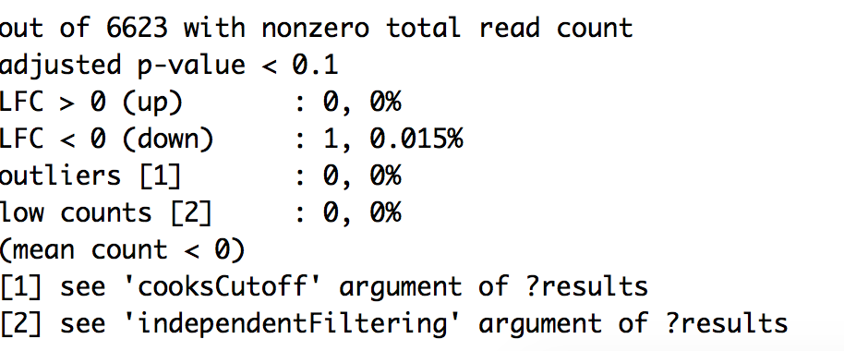
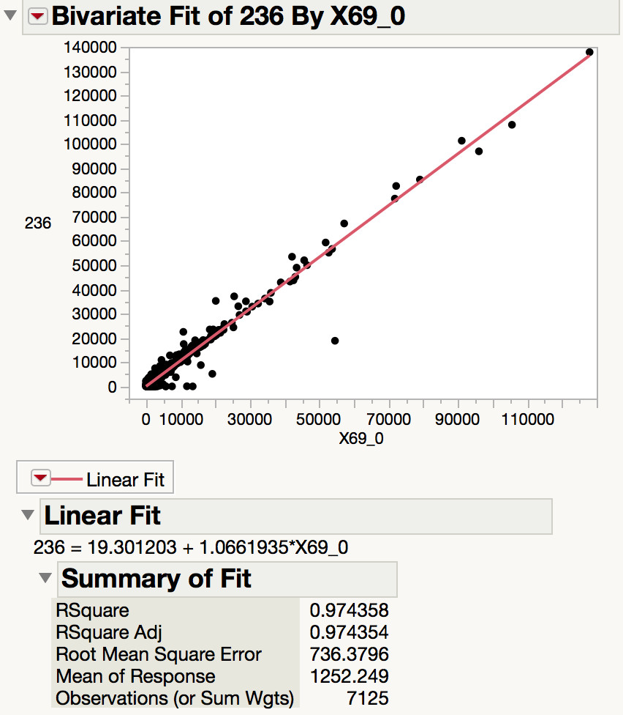
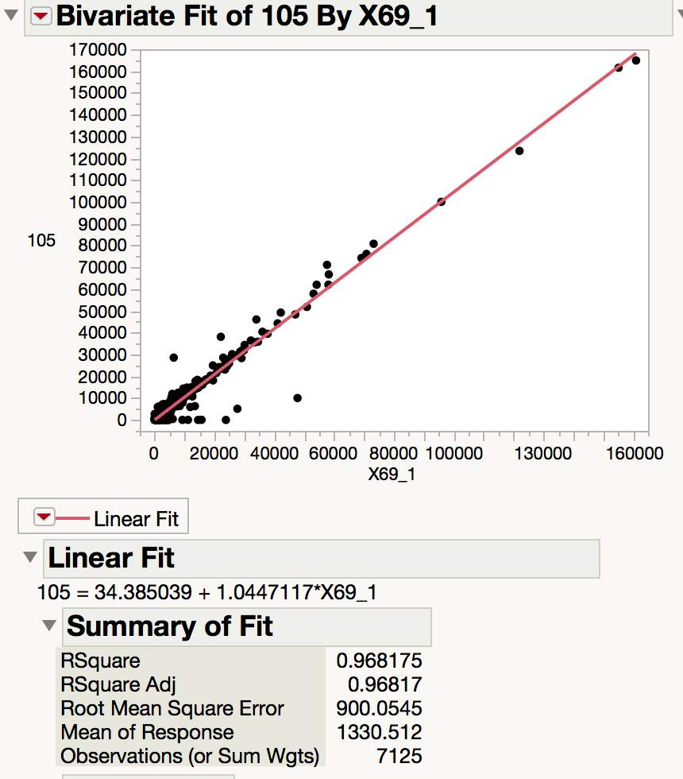
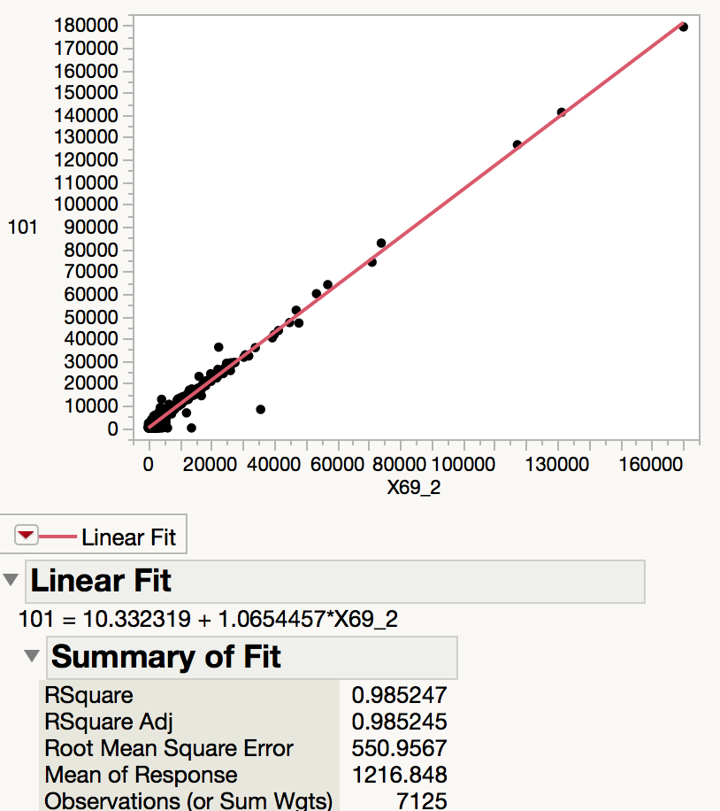
Line 69: Cufflinks gene counts versus htseq-count

Slide 15
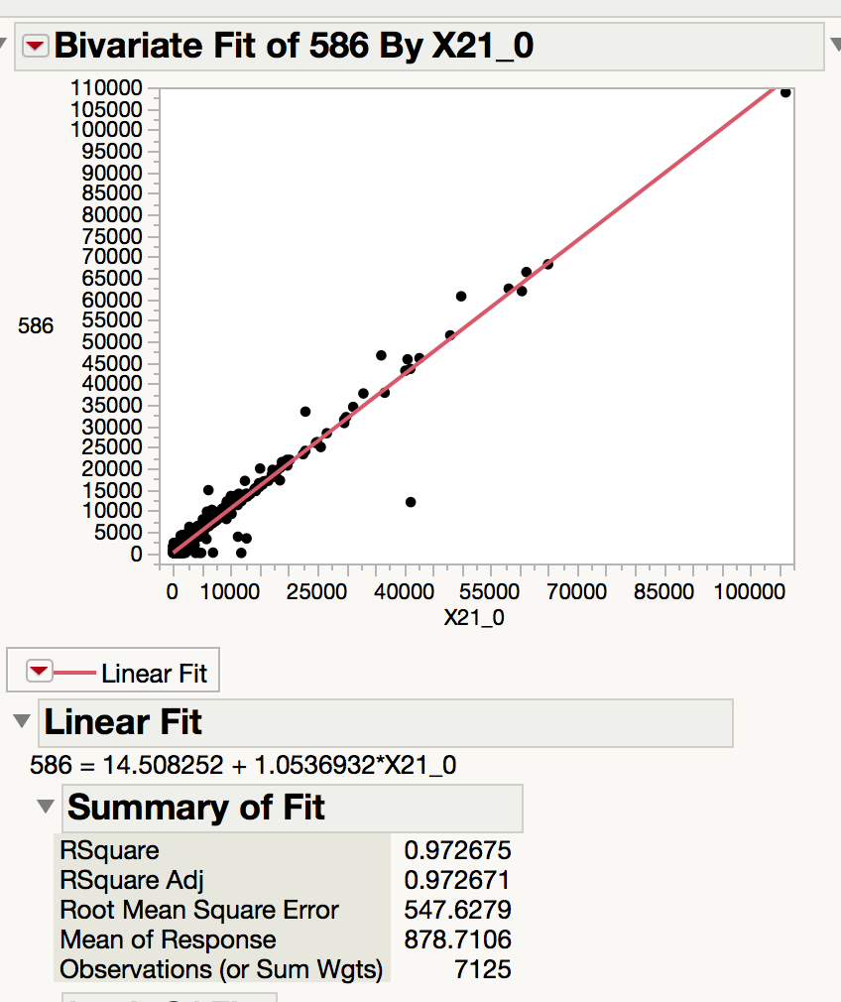
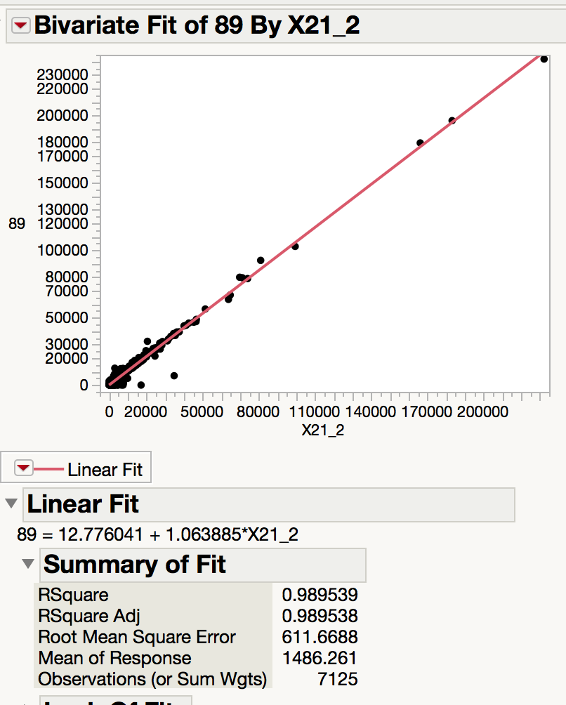
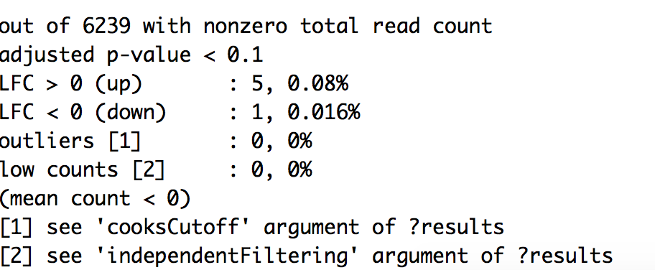
Line 21: Cufflinks gene counts versus htseq

Slide 16
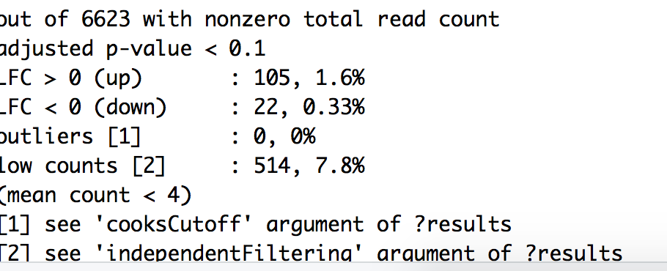
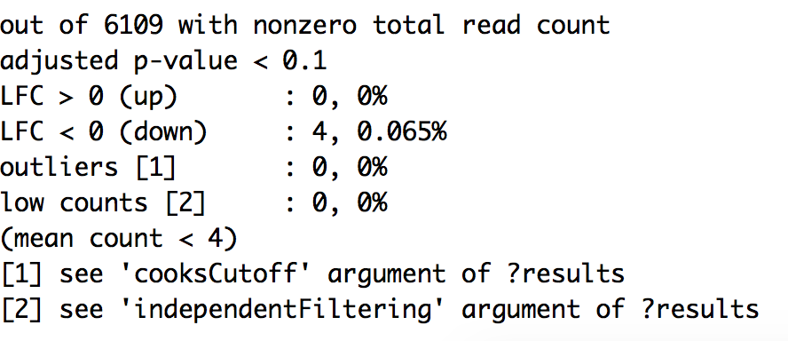
Fdrtool: estimate correct null variance for the model
Line 9: Before fdr tool correction
Line 9: After fdr tool correction

Slide 17
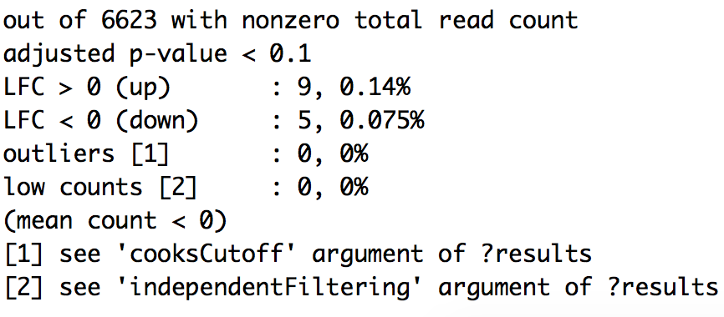
Fdrtool: estimate correct null variance for the model
Line 69: Before
Line 69: After

Slide 18
DESeq2: Running analysis with newest parameters
Htseq-count files
Make DESeqDataSet
ddsNoAneu
ddsDef
Analysis with aneuploid chromosomes removed from library normalization
Analysis with all chromosomes
Corrected null model using fdrtool
Default null model variance
Default null model variance
Corrected null model using fdrtool

Slide 19
Analysis with all chromosomes: Default Null Variance
DE genes | Sample 1 | Sample 2 | Sample 3 | Sample 4 | Sample 5 | Sample 6 | Sample 7 | Sample 8 | Sample 9 | Sample 11 | Sample 18
# LFC >0 | 19 | 520 | 626 | 85 | 1099 | 1088 | 16 | 1059 | 92 | 866 | 141
#LFC <0 | 3 | 430 | 469 | 12 | 1085 | 917 | 1 | 750 | 20 | 733 | 29
# outliers | 0 | 0 | 0 | 0 | 0 | 0 | 0 | 0 | 0 | 0 | 0
# low counts | 121 | 363 | 242 | 484 | 242 | 0 | 1088 | 242 | 0 | 0 | 242

Slide 20
Analysis with all chromosomes: Default Null Variance
DE genes | Sample 21 | Sample 31 | Sample 49 | Sample 59 | Sample 61 | Sample 66 | Sample 68 | Sample 76 | Sample 77
# LFC >0 | 5 | 0 | 77 | 208 | 186 | 0 | 0 | 218 | 214
#LFC <0 | 1 | 0 | 30 | 16 | 7 | 0 | 2 | 30 | 81
# outliers | 0 | 0 | 0 | 0 | 0 | 0 | 0 | 0 | 0
# low counts | 0 | 0 | 121 | 121 | 605 | 0 | 0 | 363 | 242

Slide 21
Analysis with aneuploid chromosomes: histograms of p-values

Slide 22
Analysis with aneuploid chromosomes: histograms of p-values

Slide 23
P value histograms: subset the data

Slide 24
Analysis without aneuploid chromosomes: Default Null Variance
DE Genes | Sample 1 | Sample 2 | Sample 3 | Sample 4 | Sample 5 | Sample 6 | Sample 7 | Sample 8 | Sample 9 | Sample 11 | Sample 18
# LFC >0 | 20 | 535 | 629 | 108 | 1110 | 1098 | 18 | 1214 | 105 | 945 | 199
#LFC <0 | 3 | 419 | 469 | 12 | 1083 | 937 | 1 | 604 | 25 | 661 | 21
# outliers | 0 | 0 | 0 | 0 | 0 | 0 | 0 | 0 | 0 | 0 | 0
# low counts | 0 | 363 | 242 | 484 | 363 | 242 | 363 | 242 | 363 | 0 | 0

Slide 25
Analysis without aneuploid chromosomes: Default Null Variance
DE genes | Sample 21 | Sample 31 | Sample 49 | Sample 59 | Sample 61 | Sample 66 | Sample 68 | Sample 76 | Sample 77
# LFC >0 | 13 | 0 | 82 | 255 | 217 | 0 | 0 | 314 | 257
#LFC <0 | 1 | 0 | 27 | 12 | 6 | 0 | 2 | 25 | 49
# outliers | 0 | 0 | 0 | 0 | 0 | 0 | 0 | 0 | 0
# low counts | 0 | 0 | 242 | 242 | 0 | 0 | 0 | 242 | 363

Slide 26
Analysis without aneuploid chromosomes: histograms of p-values

Slide 27
Analysis without aneuploid chromosomes: histograms of p-values

Slide 28
Analysis with all chromosomes: Corrected Null Variance with fdrtool
DE genes | Sample 1 | Sample 2 | Sample 3 | Sample 4 | Sample 5 | Sample 6 | Sample 7 | Sample 8 | Sample 9 | Sample 11 | Sample 18
# LFC >0
#LFC <0
# outliers
# low counts
New sd | 1.16

Slide 29
Analysis with all chromosomes: Corrected Null Variance with fdrtool
DE genes | Sample 21 | Sample 31 | Sample 49 | Sample 59 | Sample 61 | Sample 66 | Sample 68 | Sample 76 | Sample 77
# LFC >0 | 5 | 0 | 77 | 208 | 186 | 0 | 0 | 218 | 214
#LFC <0 | 1 | 0 | 30 | 16 | 7 | 0 | 2 | 30 | 81
# outliers | 0 | 0 | 0 | 0 | 0 | 0 | 0 | 0 | 0
# low counts | 0 | 0 | 121 | 121 | 605 | 0 | 0 | 363 | 242

Slide 30
Analysis without aneuploid chromosomes: Corrected Null Variance with fdrtool
DE Genes | Sample 1 | Sample 2 | Sample 3 | Sample 4 | Sample 5 | Sample 6 | Sample 7 | Sample 8 | Sample 9 | Sample 11 | Sample 18
# LFC >0 | 0 | 0 | 0 | 32 | 0 | 0 | 29 | 81 | 0 | 50 | 133
#LFC <0 | 0 | 0 | 0 | 3 | 0 | 0 | 3 | 2 | 4 | 61 | 10
# outliers | 0 | 0 | 0 | 0 | 0 | 0 | 0 | 0 | 0 | 0 | 0
# low counts | 0 | 0 | 0 | 0 | 0 | 0 | 0 | 0 | 0 | 0 | 0
New sd | 1.158232 | 2.05 | 2.024353 | 1.222808 | 2.4 | 2.4 | 0.8202633 | 2.02 | 1.605019 | 1.8 | 1.08

Slide 31
DE genes | Sample 21 | Sample 31 | Sample 49 | Sample 59 | Sample 61 | Sample 66 | Sample 68 | Sample 76 | Sample 77
# LFC >0 | 33 | 3 | 63 | 177 | 196 | 8 | 8 | 238 | 20
#LFC <0 | 8 | 3 | 17 | 7 | 5 | 6 | 4 | 17 | 0
# outliers | 0 | 0 | 0 | 0 | 0 | 0 | 0 | 0 | 0
# low counts | 0 | 0 | 0 | 0 | 0 | 0 | 0 | 0 | 0
New sd | 0.82 | 0.65 | 1.03 | 1.11 | 1.03 | 0.55 | 0.6499842 | 1.05 | 1.35

Slide 32

Sample 1: Comparison with methods
WITH Aneuploid C’somes WITHOUT Aneuploid c’somes WITHOUT, Corrected

Slide 33
Sample 2: Comparison with methods
WITH Aneuploid C’somes WITHOUT Aneuploid c’somes WITHOUT, Corrected

Slide 34
Sample 3: Comparison with methods
WITH Aneuploid C’somes WITHOUT Aneuploid c’somes WITHOUT, Corrected

Slide 35
Sample 4: Comparison with methods
WITH Aneuploid C’somes WITHOUT Aneuploid c’somes WITHOUT, Corrected PValues

Slide 36
Sample 21: Comparison with methods
WITH Aneuploid C’somes WITHOUT Aneuploid c’somes WITHOUT, Corrected

Slide 37
Sample 69: Comparison with methods
WITH Aneuploid C’somes WITHOUT Aneuploid c’somes WITHOUT, Corrected

Slide 38
The following slides have these properties:
Using full dataset (i.e. all samples, regardless of replicate #)
Using default DESeq parameters
All chromosomes included in normalization
Using default results() function parameters

Slide 39
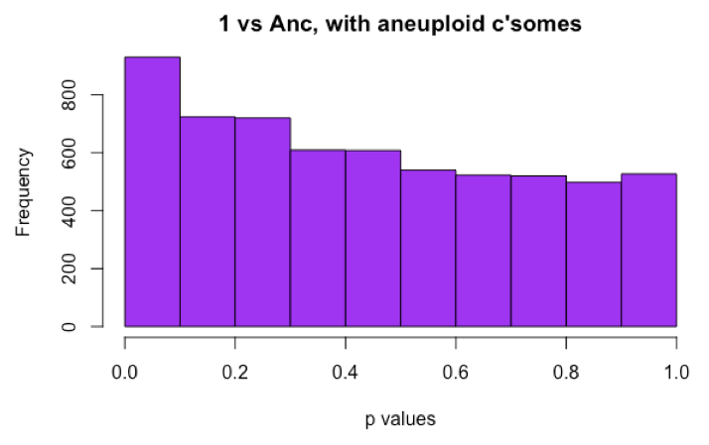
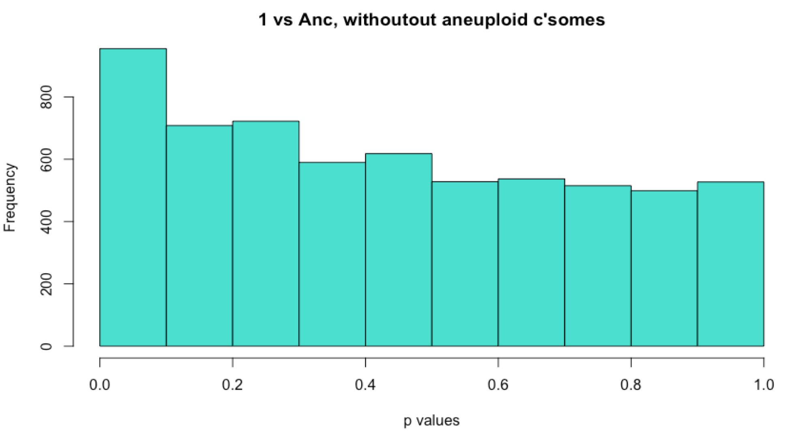
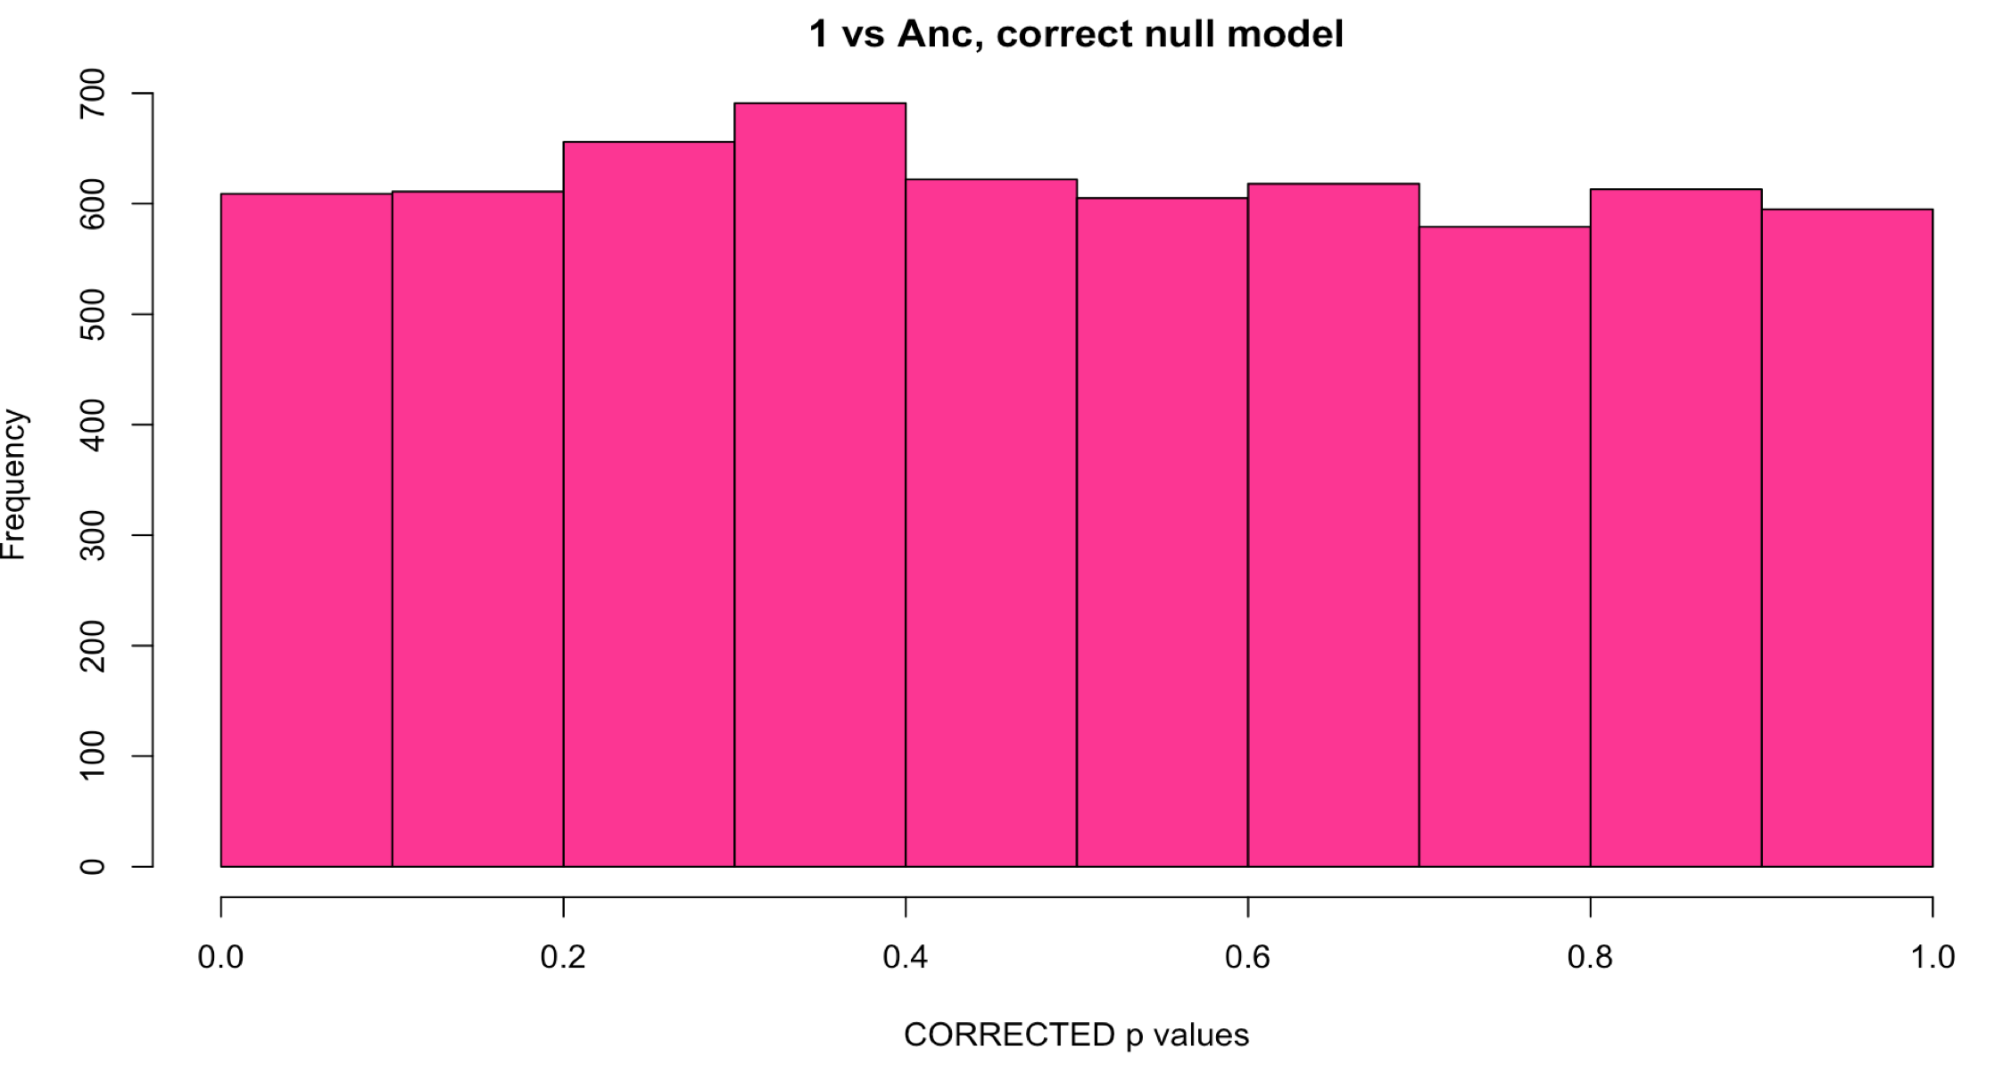
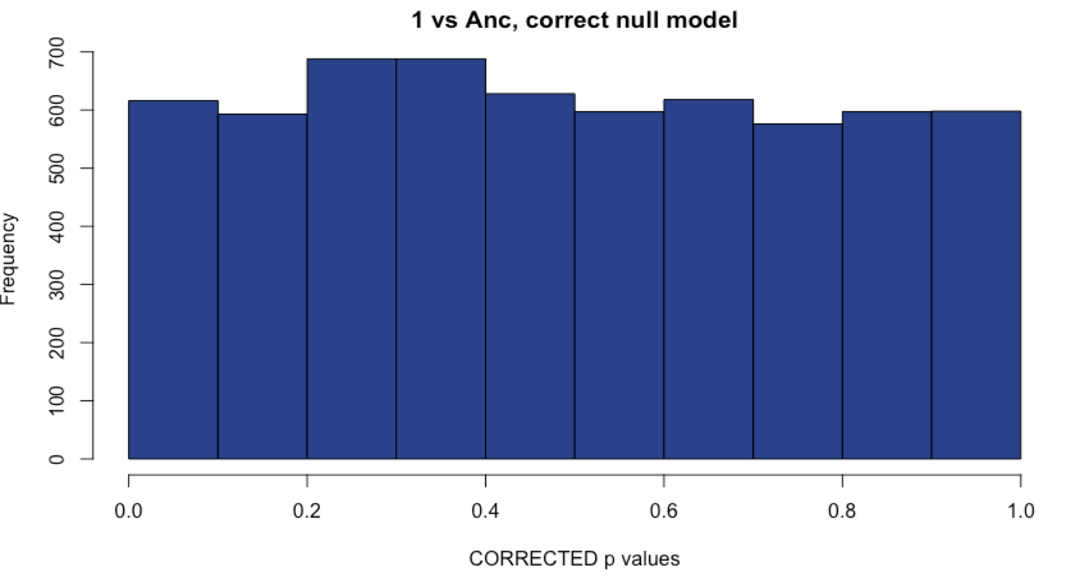

Sample 1: Comparison with methods
WITH Aneuploid C’somes WITHOUT Aneuploid c’somes
Uncorrected
Corrected with fdrtool

Slide 40
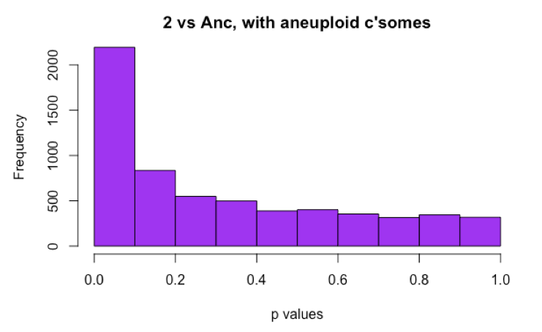
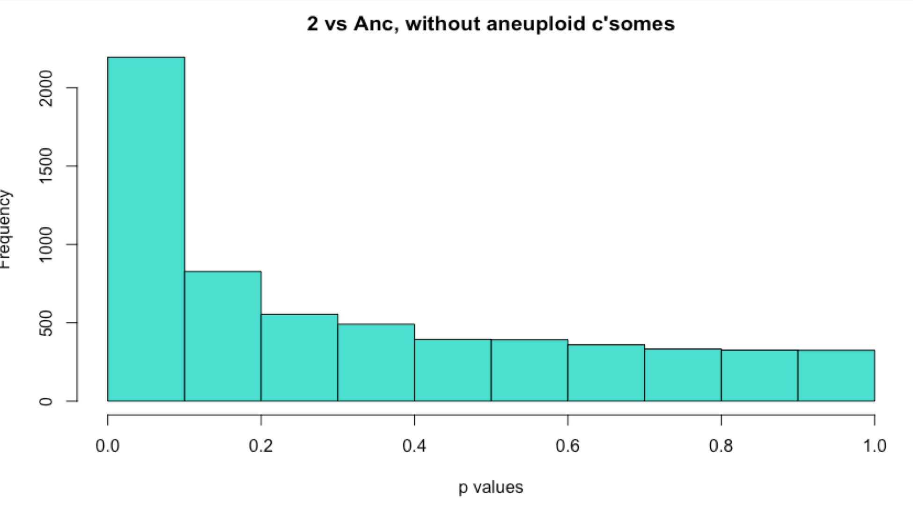
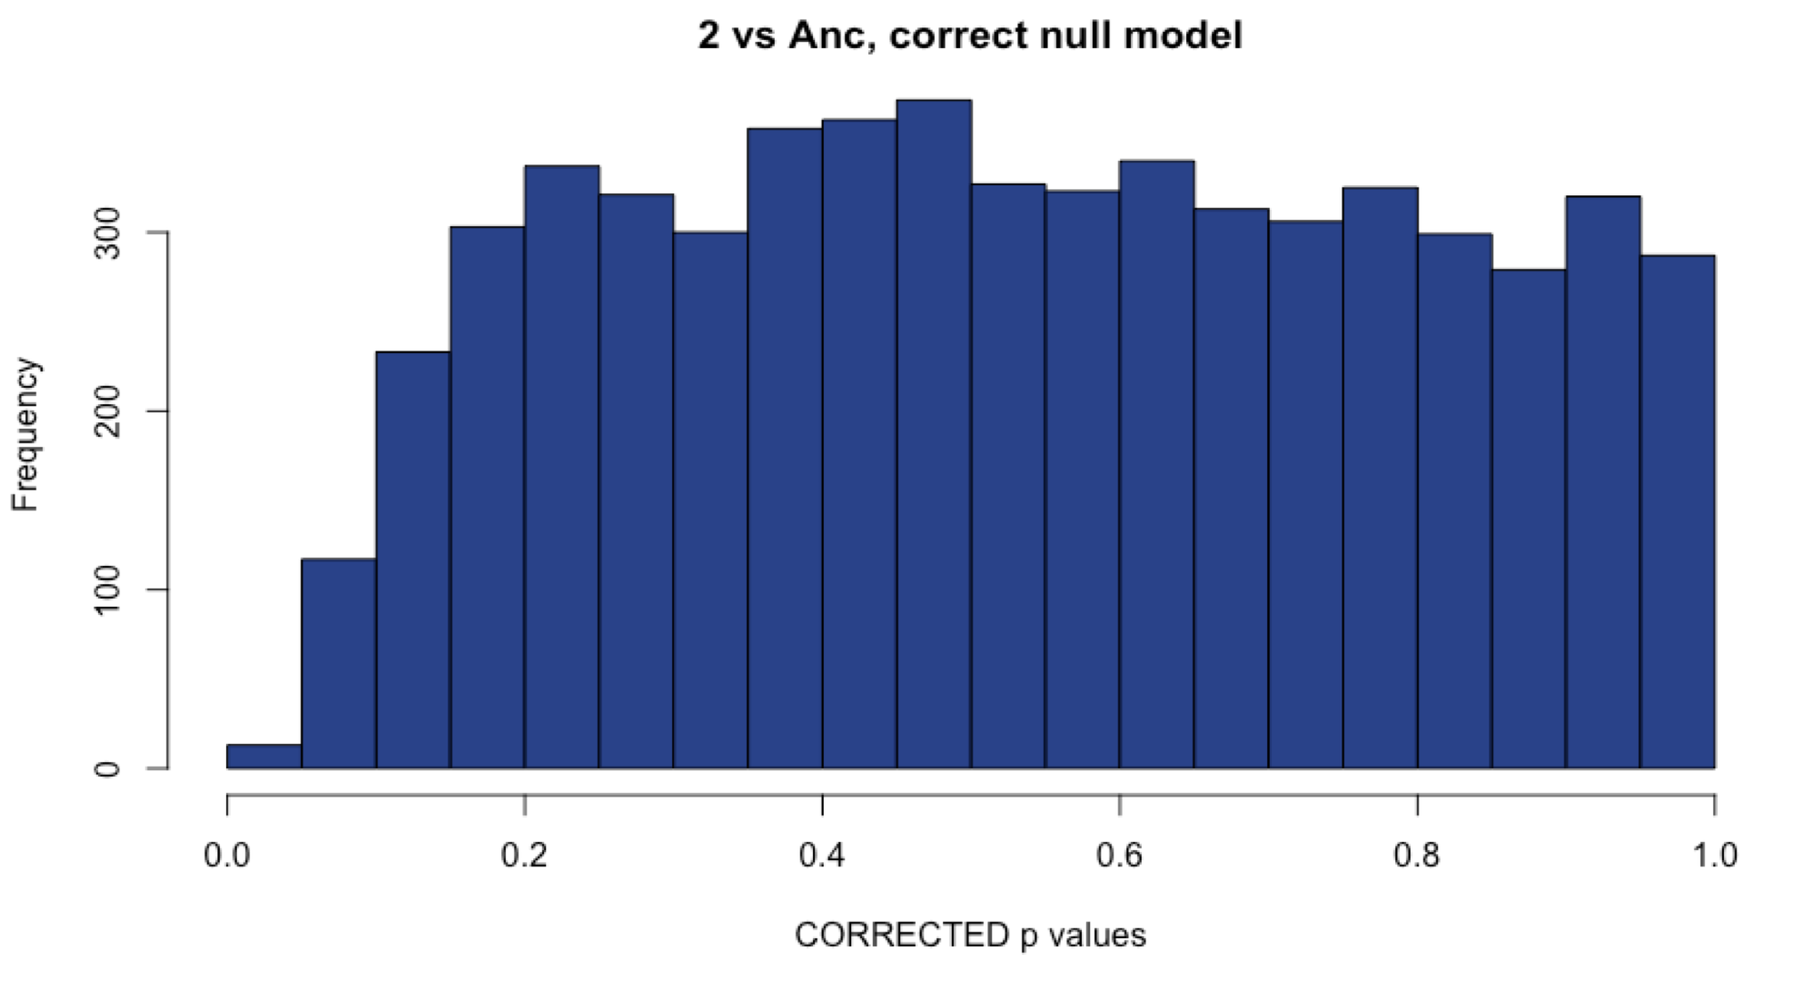
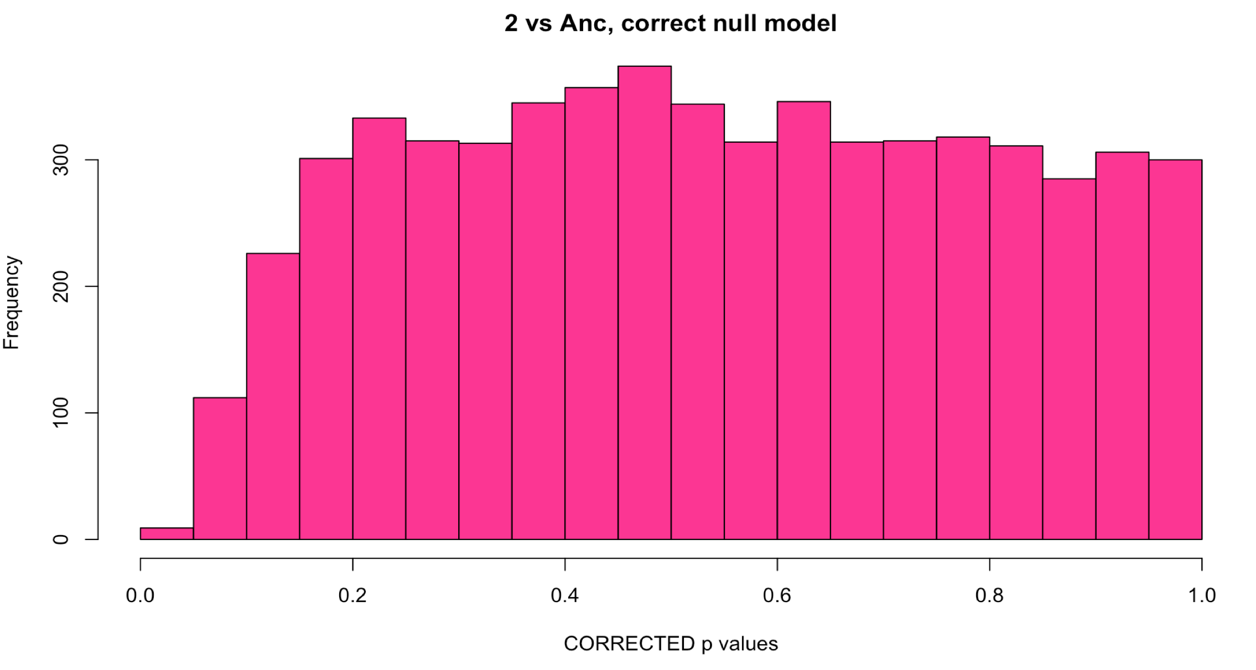
Sample 2: Comparison with methods
WITH Aneuploid C’somes WITHOUT Aneuploid c’somes
Uncorrected
Corrected with fdrtool

Slide 41
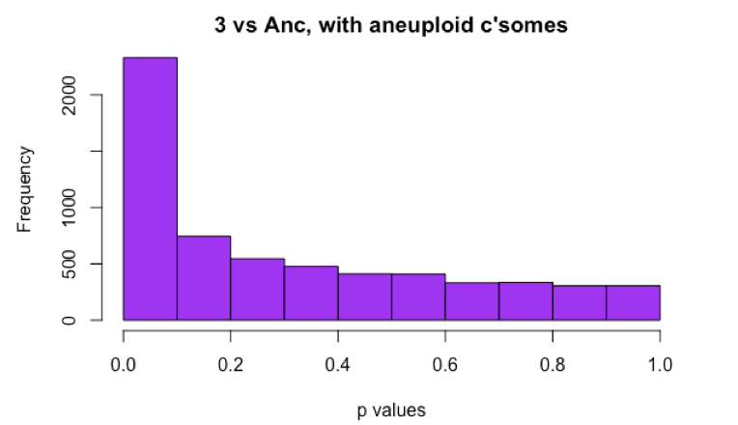
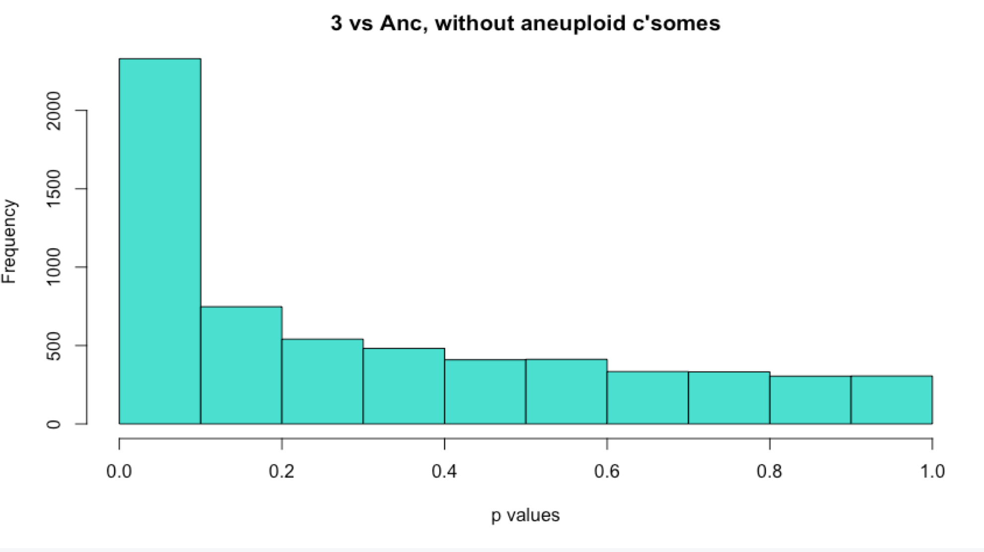
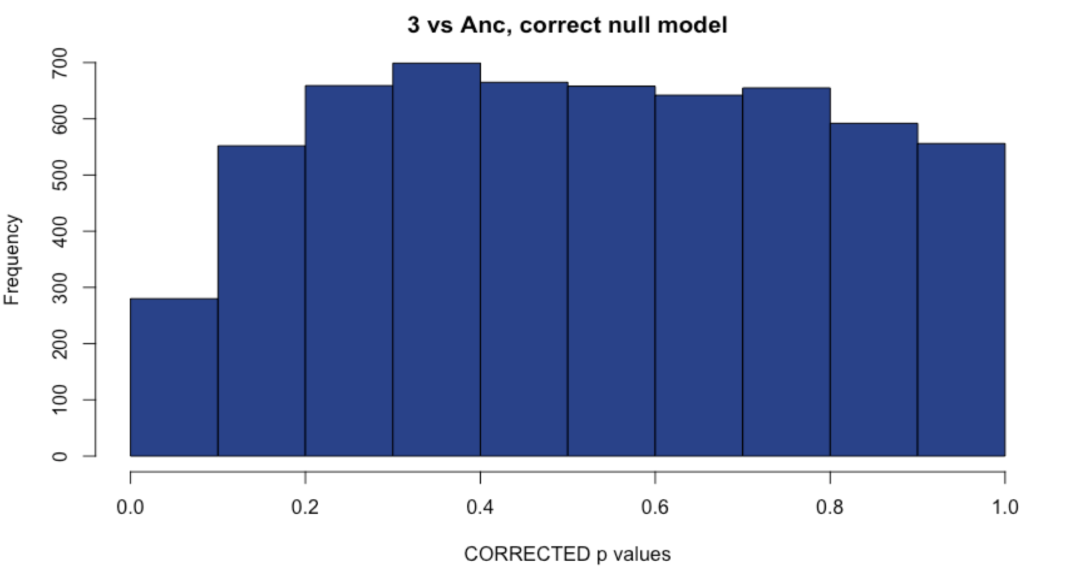
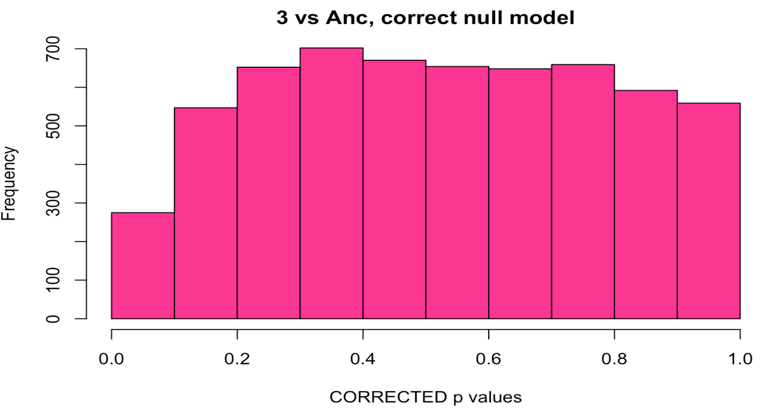
Sample 3: Comparison with methods
WITH Aneuploid C’somes WITHOUT Aneuploid c’somes
Uncorrected
Corrected with fdrtool

Slide 42
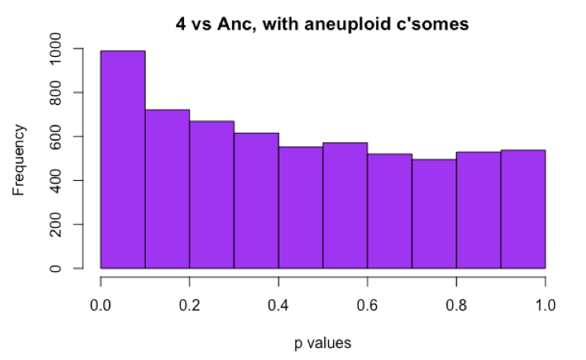
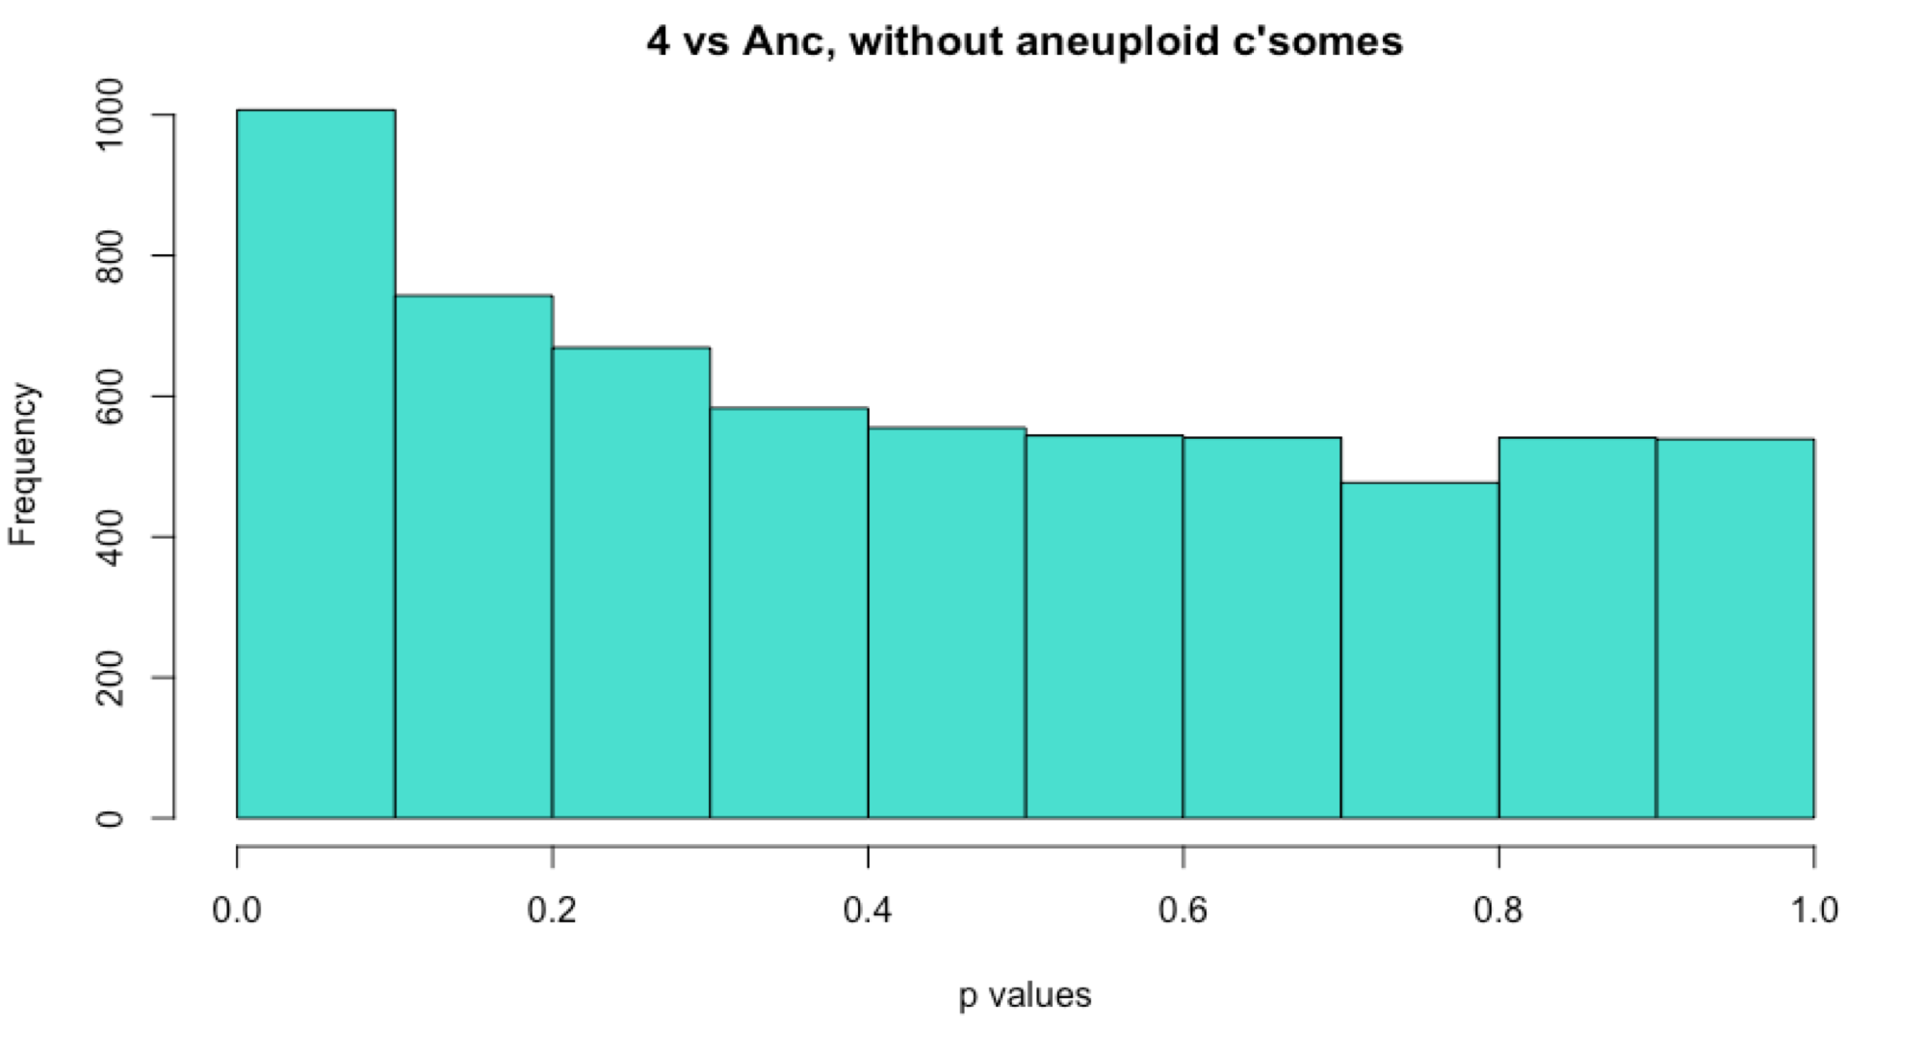
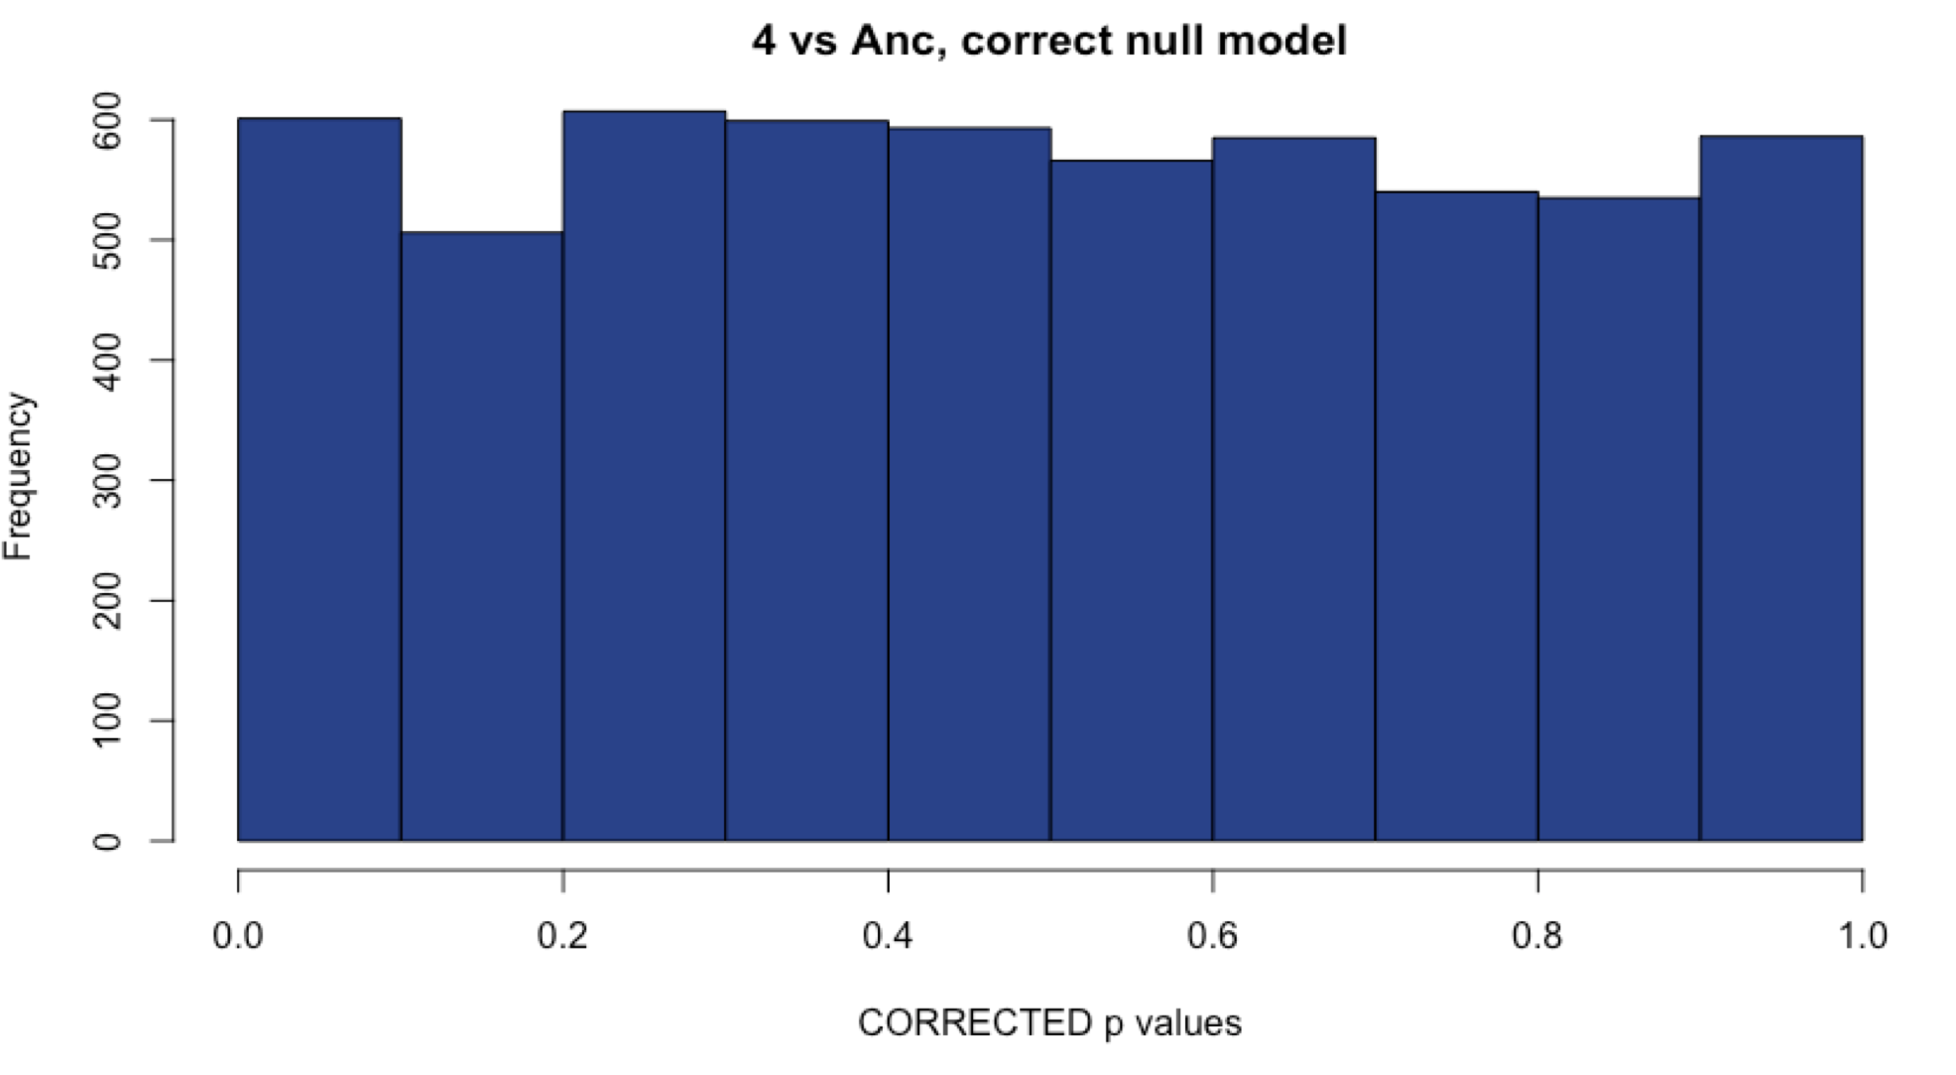
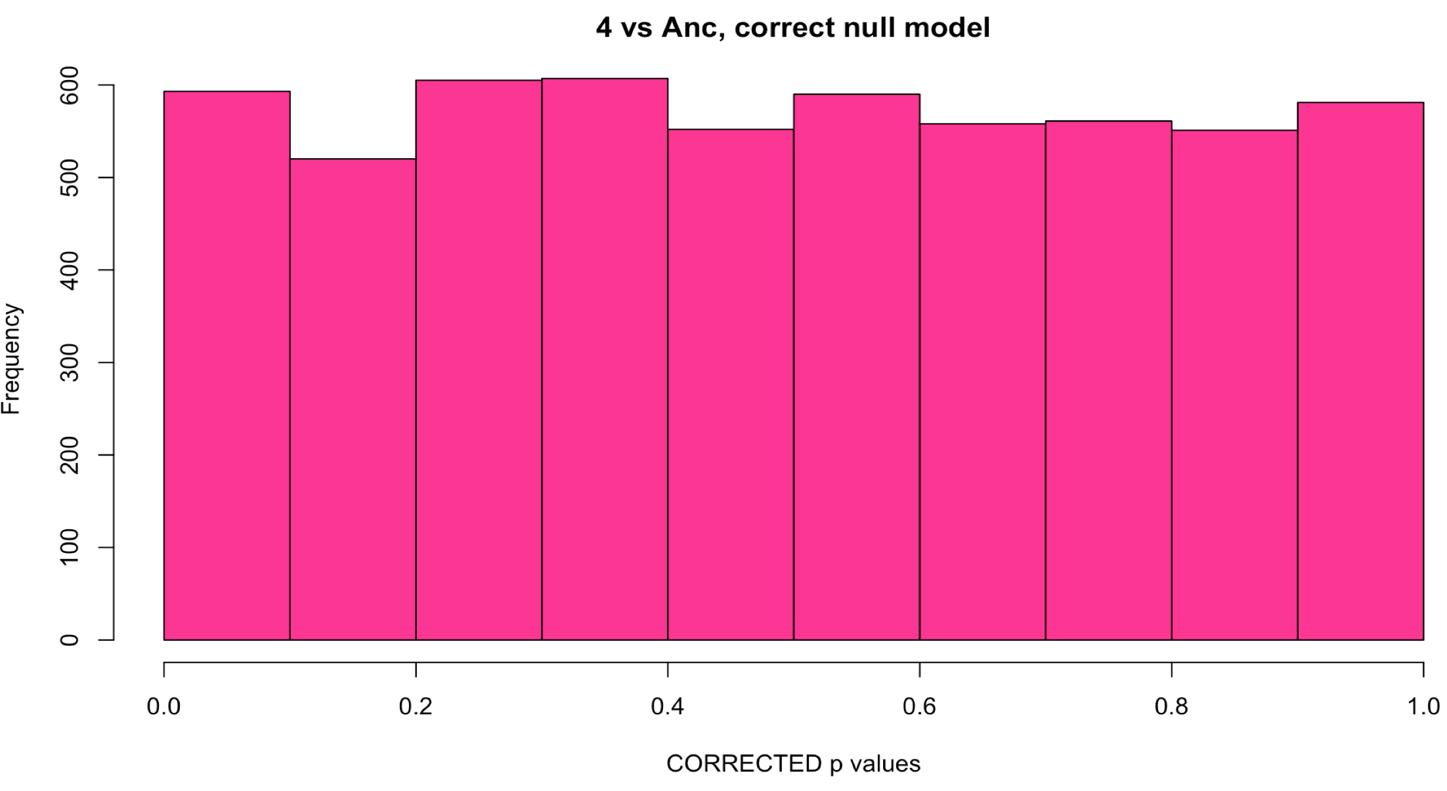
Sample 4: Comparison with methods
WITH Aneuploid C’somes WITHOUT Aneuploid c’somes
Uncorrected
Corrected with fdrtool

Slide 43
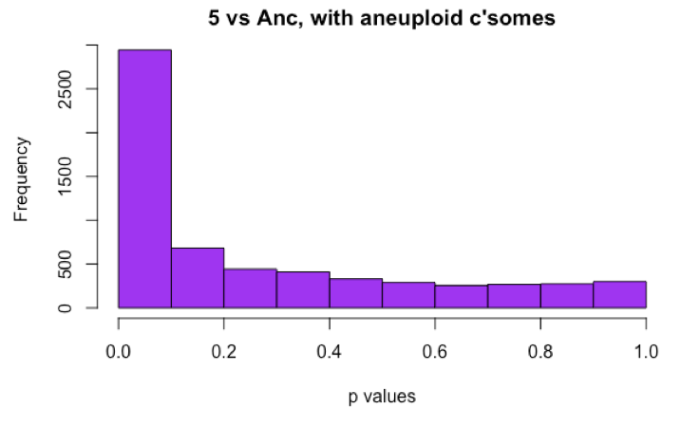
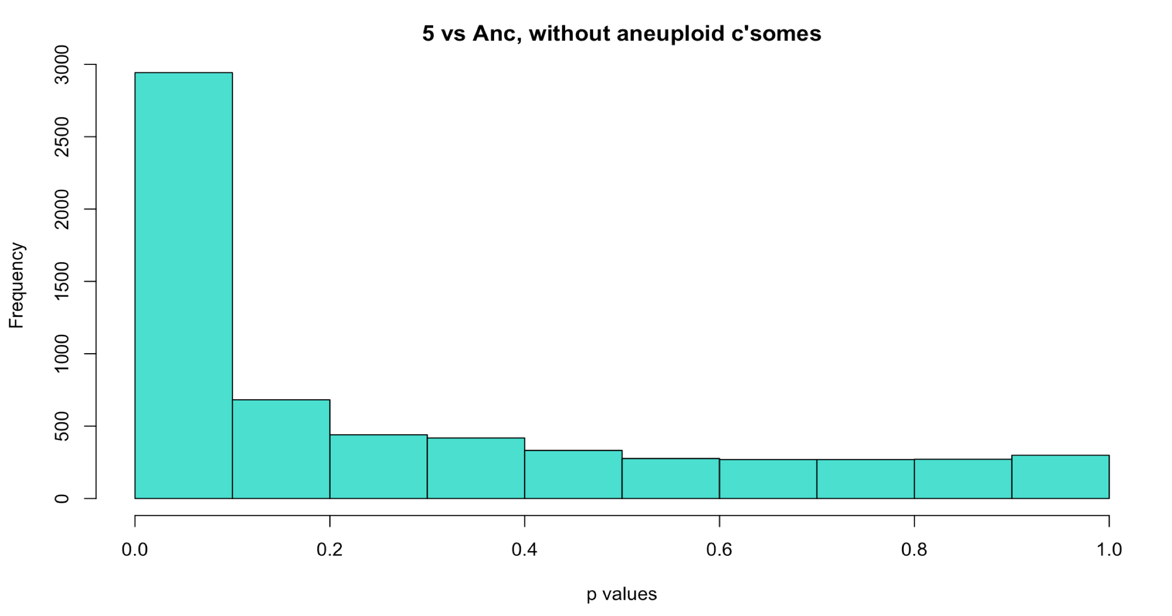
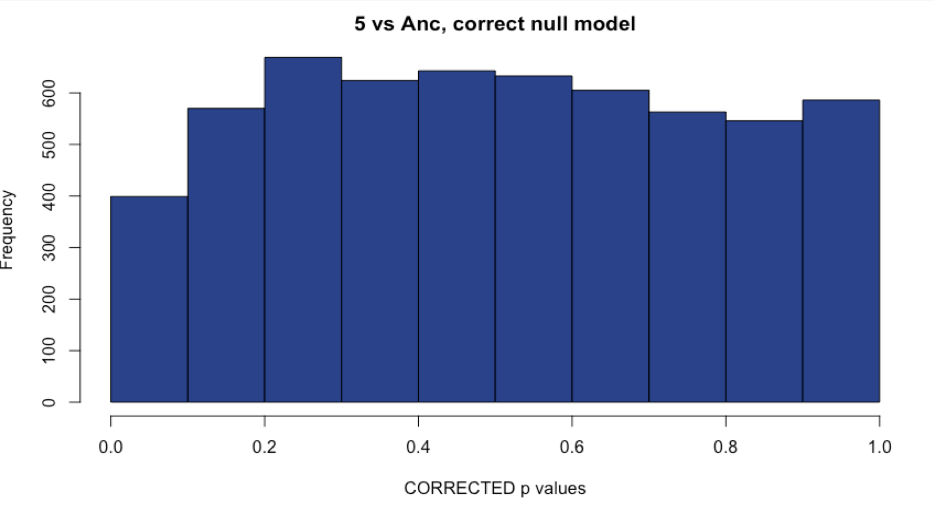
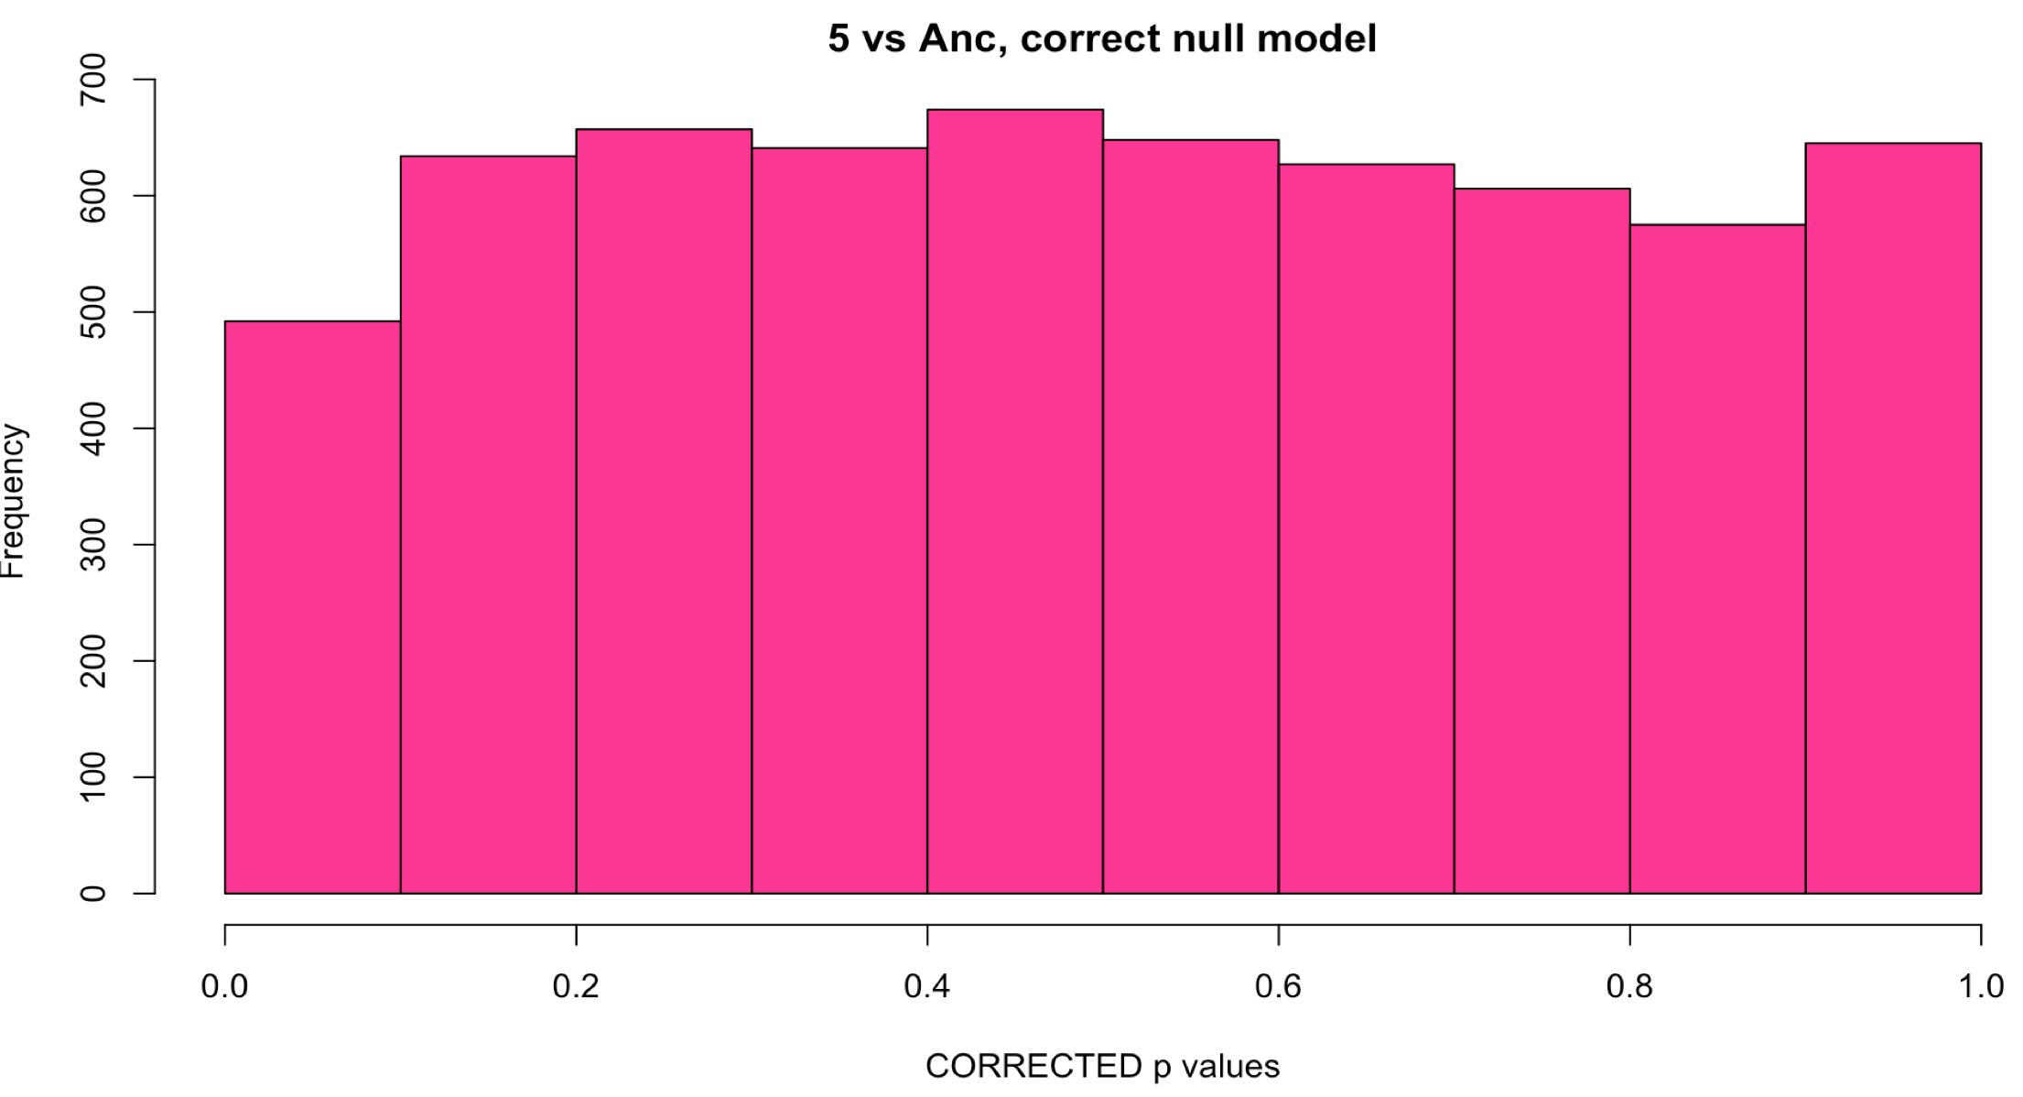
Sample 5: Comparison with methods
WITH Aneuploid C’somes WITHOUT Aneuploid c’somes
Uncorrected
Corrected with fdrtool

Slide 44




Sample 6: Comparison with methods
WITH Aneuploid C’somes WITHOUT Aneuploid c’somes
Uncorrected
Corrected with fdrtool

Slide 45




Sample 7: Comparison with methods
WITH Aneuploid C’somes WITHOUT Aneuploid c’somes
Uncorrected
Corrected with fdrtool

Slide 46




Sample 8: Comparison with methods
WITH Aneuploid C’somes WITHOUT Aneuploid c’somes
Uncorrected
Corrected with fdrtool

Slide 47




Sample 9: Comparison with methods
WITH Aneuploid C’somes WITHOUT Aneuploid c’somes
Uncorrected
Corrected with fdrtool

Slide 48




Sample 11: Comparison with methods
WITH Aneuploid C’somes WITHOUT Aneuploid c’somes
Uncorrected
Corrected with fdrtool

Slide 49




Sample 18: Comparison with methods
WITH Aneuploid C’somes WITHOUT Aneuploid c’somes
Uncorrected
Corrected with fdrtool

Slide 50




Sample 21: Comparison with methods
WITH Aneuploid C’somes WITHOUT Aneuploid c’somes
Uncorrected
Corrected with fdrtool

Slide 51




Sample 31: Comparison with methods
WITH Aneuploid C’somes WITHOUT Aneuploid c’somes
Uncorrected
Corrected with fdrtool

Slide 52




Sample 49: Comparison with methods
WITH Aneuploid C’somes WITHOUT Aneuploid c’somes
Uncorrected
Corrected with fdrtool

Slide 53




Sample 59: Comparison with methods
WITH Aneuploid C’somes WITHOUT Aneuploid c’somes
Uncorrected
Corrected with fdrtool

Slide 54




Sample 61: Comparison with methods
WITH Aneuploid C’somes WITHOUT Aneuploid c’somes
Uncorrected
Corrected with fdrtool

Slide 55




Sample 66: Comparison with methods
WITH Aneuploid C’somes WITHOUT Aneuploid c’somes
Uncorrected
Corrected with fdrtool

Slide 56




Sample 69: Comparison with methods
WITH Aneuploid C’somes WITHOUT Aneuploid c’somes
Uncorrected
Corrected with fdrtool

Slide 57




Sample 76: Comparison with methods
WITH Aneuploid C’somes WITHOUT Aneuploid c’somes
Uncorrected
Corrected with fdrtool

Slide 58




Sample 77: Comparison with methods
WITH Aneuploid C’somes WITHOUT Aneuploid c’somes
Uncorrected
Corrected with fdrtool

Slide 59
The following slides have these properties:
Using only lines that are behaving
Excluding: 7, 21, 31, 66, 69
Using default DESeq parameters
All chromosomes included in normalization
Using default results() function parameters

Slide 60



Sample 1: Comparison with methods
WITH Aneuploid C’somes WITHOUT Aneuploid c’somes
Uncorrected
Corrected with fdrtool

Slide 61



Sample 2: Comparison with methods
WITH Aneuploid C’somes WITHOUT Aneuploid c’somes
Uncorrected
Corrected with fdrtool

Slide 62



Sample 3: Comparison with methods
WITH Aneuploid C’somes WITHOUT Aneuploid c’somes
Uncorrected
Corrected with fdrtool

Slide 63



Sample 4: Comparison with methods
WITH Aneuploid C’somes WITHOUT Aneuploid c’somes
Uncorrected
Corrected with fdrtool

Slide 64



Sample 5: Comparison with methods
WITH Aneuploid C’somes WITHOUT Aneuploid c’somes
Uncorrected
Corrected with fdrtool

Slide 65




Sample 6: Comparison with methods
WITH Aneuploid C’somes WITHOUT Aneuploid c’somes
Uncorrected
Corrected with fdrtool

Slide 66



Sample 8: Comparison with methods
WITH Aneuploid C’somes WITHOUT Aneuploid c’somes
Uncorrected
Corrected with fdrtool

Slide 67



Sample 9: Comparison with methods
WITH Aneuploid C’somes WITHOUT Aneuploid c’somes
Uncorrected
Corrected with fdrtool

Slide 68



Sample 11: Comparison with methods
WITH Aneuploid C’somes WITHOUT Aneuploid c’somes
Uncorrected
Corrected with fdrtool

Slide 69



Sample 18: Comparison with methods
WITH Aneuploid C’somes WITHOUT Aneuploid c’somes
Uncorrected
Corrected with fdrtool

Slide 70



Sample 49: Comparison with methods
WITH Aneuploid C’somes WITHOUT Aneuploid c’somes
Uncorrected
Corrected with fdrtool

Slide 71



Sample 59: Comparison with methods
WITH Aneuploid C’somes WITHOUT Aneuploid c’somes
Uncorrected
Corrected with fdrtool

Slide 72



Sample 61: Comparison with methods
WITH Aneuploid C’somes WITHOUT Aneuploid c’somes
Uncorrected
Corrected with fdrtool

Slide 73



Sample 76: Comparison with methods
WITH Aneuploid C’somes WITHOUT Aneuploid c’somes
Uncorrected
Corrected with fdrtool

Slide 74



Sample 77: Comparison with methods
WITH Aneuploid C’somes WITHOUT Aneuploid c’somes
Uncorrected
Corrected with fdrtool

Slide 75
The following slides have these properties:
Using only lines that have 3 replicates
Excluding: 21, 66
Using default DESeq parameters
All chromosomes included in normalization
Using default results() function parameters

Slide 76



Sample 1: Comparison with methods
WITH Aneuploid C’somes WITHOUT Aneuploid c’somes
Uncorrected
Corrected with fdrtool

Slide 77



Sample 2: Comparison with methods
WITH Aneuploid C’somes WITHOUT Aneuploid c’somes
Uncorrected
Corrected with fdrtool

Slide 78



Sample 3: Comparison with methods
WITH Aneuploid C’somes WITHOUT Aneuploid c’somes
Uncorrected
Corrected with fdrtool

Slide 79



Sample 4: Comparison with methods
WITH Aneuploid C’somes WITHOUT Aneuploid c’somes
Uncorrected
Corrected with fdrtool

Slide 80



Sample 5: Comparison with methods
WITH Aneuploid C’somes WITHOUT Aneuploid c’somes
Uncorrected
Corrected with fdrtool

Slide 81



Sample 6: Comparison with methods
WITH Aneuploid C’somes WITHOUT Aneuploid c’somes
Uncorrected
Corrected with fdrtool

Slide 82

Sample 7: Comparison with methods
WITH Aneuploid C’somes WITHOUT Aneuploid c’somes
Uncorrected
Corrected with fdrtool

Slide 83



Sample 8: Comparison with methods
WITH Aneuploid C’somes WITHOUT Aneuploid c’somes
Uncorrected
Corrected with fdrtool

Slide 84



Sample 9: Comparison with methods
WITH Aneuploid C’somes WITHOUT Aneuploid c’somes
Uncorrected
Corrected with fdrtool

Slide 85



Sample 11: Comparison with methods
WITH Aneuploid C’somes WITHOUT Aneuploid c’somes
Uncorrected
Corrected with fdrtool

Slide 86



Sample 18: Comparison with methods
WITH Aneuploid C’somes WITHOUT Aneuploid c’somes
Uncorrected
Corrected with fdrtool

Slide 87



Sample 31: Comparison with methods
WITH Aneuploid C’somes WITHOUT Aneuploid c’somes
Uncorrected
Corrected with fdrtool

Slide 88



Sample 49: Comparison with methods
WITH Aneuploid C’somes WITHOUT Aneuploid c’somes
Uncorrected
Corrected with fdrtool

Slide 89



Sample 59: Comparison with methods
WITH Aneuploid C’somes WITHOUT Aneuploid c’somes
Uncorrected
Corrected with fdrtool

Slide 90



Sample 61: Comparison with methods
WITH Aneuploid C’somes WITHOUT Aneuploid c’somes
Uncorrected
Corrected with fdrtool

Slide 91



Sample 69: Comparison with methods
WITH Aneuploid C’somes WITHOUT Aneuploid c’somes
Uncorrected
Corrected with fdrtool

Slide 92



Sample 76: Comparison with methods
WITH Aneuploid C’somes WITHOUT Aneuploid c’somes
Uncorrected
Corrected with fdrtool

Slide 93



Sample 77: Comparison with methods
WITH Aneuploid C’somes WITHOUT Aneuploid c’somes
Uncorrected
Corrected with fdrtool

